Slide 1
Communicating Data to External Audiences March 20, 2017
Notes:
The topic was derived from program partners like yourself. We’ve heard from a number of folks that it’s incredibly valuable to receive quantitative data at the end of the programming cycle to see where you are and to identify strengths and weaknesses. However, people were looking for additional support and ideas about how to translate program-level data into compelling messages for external audiences.
Scope of event – by no means will this event serve as an exhaustive how-to guide on all things related to communications –rather we see it as an important starting point for this network to talk about how you’ve communicated this data to date, and to begin sharing new ideas that you adopt in your practice

Slide 2
Agenda
9:00 – 9:15 Breakfast and Registration
9:15 – 9:30 Introductions and Opening Activity
9:30 – 10:00 Presentation on Strategies to Communicate Data
10:00 – 10:30 Applying Strategies to Communication Materials
Table Discussion
10:30 – 10:40 Break and Refreshments
10:40 – 11:40 Crafting Data Narratives for Various Audiences
Rotating Small Group Discussion:
Parents
Funders/Donors
Board Members
11:40 – 12:00 Sharing Out and Next Steps

Slide 3
Ground Rules
Participate actively
Remember that everything is context dependent
Trust your expertise
Notes:
The success of this event is contingent on active participation from us and all of you. As we go through these slides, stop us at any point to ask questions or share something similar that you’ve tried. We’ve curated a number of communications tips from our end, but it’s certainly not an exhaustive list. We’re hoping to learn from all of you in the room.
Everything we will talk about it is context dependent – one of the strategies we will discuss is to lead with your organization’s outcomes, not the convoluted intricacies of your process. Generally, this is a best practice. But this might not work for everyone. If you have a Board member who’s been with your org for a decade and is completely fluent in your goals and vision – then perhaps you’d instead want to instead go in to the weeds with this particular individual and highlight a new component of your staff hiring process.
Trust your expertise – BASB knows quantitative data. You’re the experts in the qualitative data, as well as the day to day operations. you know your audiences and stakeholders best. Take these strategies and adapt them to the specific realities of your program.

Slide 4
Strategies for Communicating Data
1. Creating a Culture of Data
2. Visualizing Data
3. Building a Narrative
Notes:
Strategies fall into three general buckets
These categories are not mutually exclusive – you’ll notice that these tips and strategies blend into each other.
Refer to the handout (second page of your packet) to take notes and follow along

Slide 5
1. Creating a Culture of Data
Repeat messages frequently
View data as the starting point for dialogue – not the end point
Develop a system for internal knowledge transfer
Have healthy skepticism about data (both good and bad news)
CONCRETE TIPS
Use multiple modes of communication
Use citations and reliable sources
Notes:
Remember that consistency and repetition is the key to persuasion. People need to hear the same ideas repeatedly from a variety of sources, before they sink in. And that repetition is most effective when the language is the same. Use consistent lines and phrases across staff and all modes of communication. Have fewer key phrases – but say them for frequently. You want to move through three phrases of persuasion:
Credibility – a reputable org in town
Familiarity – an org that a family would be comfortable sending their child to
First thought – the preeminent org that comes to mind when thinking of a youth serving program
Don’t assume that everyone views the data from the same perspective.
There is a tendency to present the data at the end of programming, and say “So this is how we did.” Instead of as a starting point for a conversation. Data should discussed regularly, by and with all staff, embedded in conversations all year round.
Limitations to data – different students and staff every year. It’s a snapshot at one point in time. Should be as skeptical about good news as we are about bad news. Especially if we didn’t do anything dramatically different but still saw overwhelming positive gains.
Multiple mediums of communication
Different learning styles
Combine narrative with examples; case studies with graphics
Citations establish credibility and show that you’ve done your homework. Also, helps provide direction if people want to learn more.

Slide 6
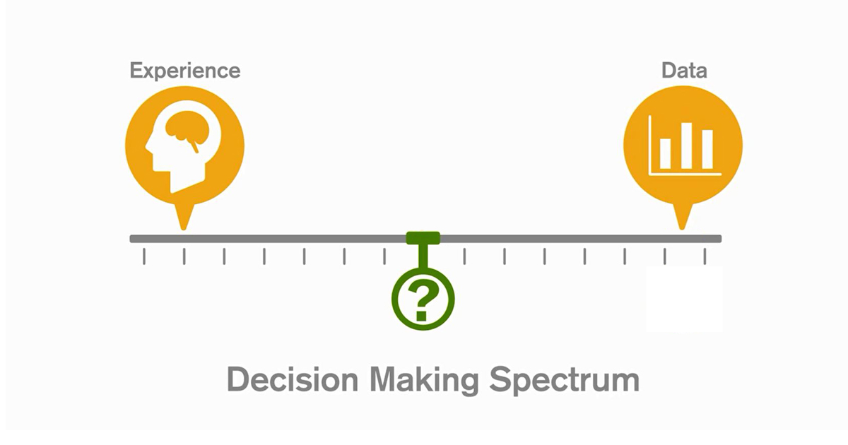
Data as the Starting Point
Informed by Community Research Institute’s Nonprofits and Data: A How-To Series
Notes:
It is important to remember that not everyone sees data the same way. For example, data might not resonate well with specific people if it is inconsistent with their experiences or knowledge base. Because of this, it is wise to acknowledge any limitations the data might have and to present data as a starting point for conversation, not a conclusion.
Suggested questions to ask stakeholders based on the data:
Does this data support or contradict your experiences?
Can you tell a story that backs up this data? If not, how has your experience been different?
What stands out to you about this data?
This is what I think the data means. How do you interpret it?
What might be influencing this data? Are there factors that cause to numbers to go higher or to drop?
Who else needs to see this data?

Slide 7
System for Knowledge Transfer
Program staff/ Counselors
Communications team
Program Leadership
Development team
Recruitment/ Engagement Leads
Informed by examples from St. Stephen’s Youth Programs and Achieve
Notes:
Some people are well versed in the qualitative data – the stories of what kids are doing day-to-day in the program. Some people are more knowledgeable about the quantitative data (executive director, database manger) – annual numbers of students severed across all programs and overall program quality trends over time.
It’s important to have a platform and system for sharing knowledge with each other – because both pieces of data are vital – especially when reporting back to funders and your board of directors. It’s common for development and communications folks to scramble around and ask program staff for student quotes and anecdotes right before a grant proposal deadline or before a board meeting. This Info is spread across multiple people, so how do you enable seamless knowledge sharing across your staff?
Example: At St. Stephen Youth Programs, staff keeps a compendium of anecdotal and qualitative data to share with their development team. This is a shared collaborative document that everyone has access to. This means that camp counselors can fill in notes about a great conversation that they had with a student or parent, and the database point person can add in demographic information about all students that might be useful to other team members.

Slide 8
2. Visualizing Data
Focus on accessibility
Offer context and perspective
Create punchy images
Leverage diverse tools
CONCRETE TIPS
Use the most recent data source available
Use the most localized data available
Notes:
Accessibility – some colors, graphs, and statistics are more accessible than others. This is something we’ll discuss further on the next slide.
Offer context – A common mistake is to just present a single number as a data point – for example, having an 80% attendance rate this year. But is that good? Is that what you were expecting to see. It’s always important to answer the following questions:
Compared to what?
Compared to whom?
Compared to when?
There are many great image creation and database visualization tools out there. We’ll share some examples later on in this presentation.
Concrete tips:
Most recent source available. There are a number of seminal studies out there, but it’s important to be mindful that studies get outdated quickly. Especially when looking at publically available data (e.g. census tracked data) and demographic data, be sure to use the most recent figures possible.
Most localized source. Drill down to the most narrow and specific data possible for the communities and neighborhoods that you serve. State-level statistics about high school graduation are not as compelling for those just about Boston, or better yet a particular neighborhood that you target.

Slide 9
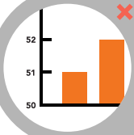
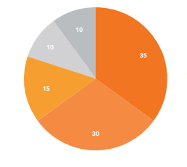
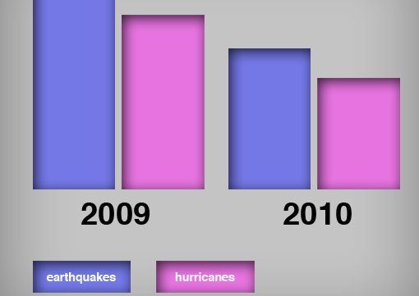
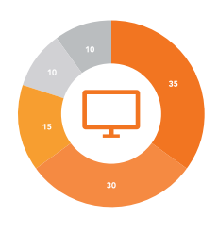
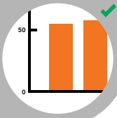
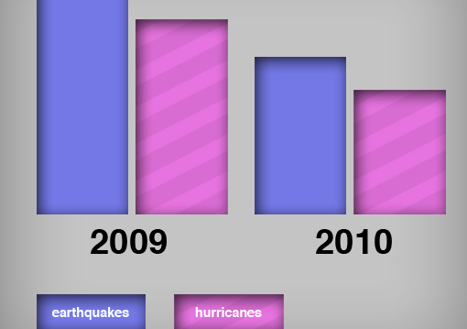
A Accessible Visualizations
Include a zero baseline if possible
Use textures (and colors) to show differences
Add a visual
element to charts
Notes:
1) Use a zero baseline as much as possible. Otherwise the visual can distort and arbitrarily magnify growth that is just not meaningful. Show honest depictions of change over time
2) People have difficulty discerning slightly different color gradients. This is especially true for color blind and visually impaired individuals. To combat this, consider using textures (in addition) to color differences. Furthermore, think about the main point of the chart. If you’re looking to compare two different phenomena (like the frequency of earthquakes and hurricanes in this example), consider reconfiguring the graph to have the natural disaster as the primary data point with the different dates as the secondary point.
3) Pie charts are commonly used but sometimes not as intuitive to understand. In this example, the respective numbers are too small and the color gradients are too similar. Furthermore, since there’s no header in this example, one would need to read additional text to understand what this pie chart is depicting. To get around this, consider using a donut chart instead of a pie chart. Donuts enable you to add an icon depicting the main purpose of the graphic, or to emphasize the most important statistic (e.g. 35% of people primarily get news from the internet).

Slide 10
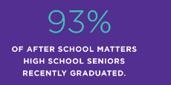
Infographics
United Way of Massachusetts Bay and Merrimack Valley
Steppingstone Foundation
After School Matters, Chicago
Notes:
Infographics are a great way to make data come alive. We have a tendency to use charts that show every single domain that we measure, but no one reads all of the fine print in the x axis. Instead, identify what are the most important 1-2 takeaway messages and translate them into infographics.
Some common elements of these three examples
They limit themselves to just one prominent number
They include images or icons that reflect the type of info portrayed
They can stand alone. All of these infographics were pulled from much longer reports or documents, but what works well about these examples is that you don’t need any further information or text to comprehend what is being stated. So once you make this infographic, your team can readily share it multiple ways like on social media, an annual report, a board presentation, etc.

Slide 11
Examples of Visualization Tools
Create Images
Make icons from black and white images: The Noun Project
Transform existing images into icon shapes: ICO Convert
Customize infographic templates: Canva
Create Graphs
Google Charts
Plotly
Chartblocks
Silk
Create Maps
ArcGIS Online
Google MyMaps
Miscellaneous
Make a word cloud: Tagul
Collect poll data in real time: Poll Everywhere
Notes:
Most of these are free and open source – free to the user, but publically available so don’t use confidential or sensitive information.
Noun Project – simple black and white icons that are ready to be made into icon images like those use throughout this presentation
ICO Convert – take existing images like photos of students and transform them into icon shapes
Canva – great, user-friendly resource that has may pre-made customizable infographic templates
Graphs – all of these examples plug into your data and produce gorgeous, compelling visual tables and graphs. Must better than the default ones in Excel and PPT. Basic version is free for users; need to pay for premium versions
Maps – great tools to show visually what neighborhoods or schools or students come from. Connect with Kelsey Cowen at Boston After School & Beyond if you have questions about this.
Word cloud – good way to emphasize frequency or common themes
Live polling software – show audience responses in real time.

Slide 12
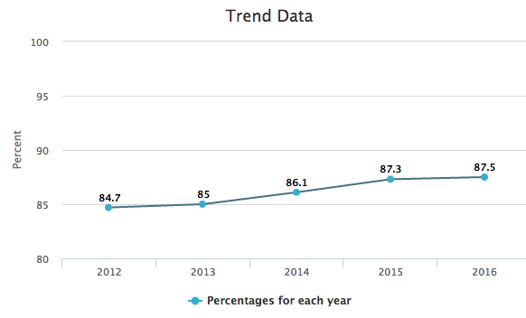
Most Localized Data Available
Massachusetts’ average graduation rate increased by 0.2 percentage points to 87.5% in 2016, compared to 87.3% for the 2015 cohort.
Across Boston, 72.4% of eligible high school students graduated on time in SY15-16.
Three out of four high school seniors that participated in our program last year graduated on time.
Notes:
Examples get better as you move progressively more local. Always bring the data back to student level and present the most geographically targeted information available.

Slide 13
3. Building a Narrative
Focus on accessibility
Tell a causal story
Translate weaknesses into actionable strategies for improvement
Lead with your outcomes, rather than the process
CONCRETE TIPS
Use multiple voices and perspectives
Use examples liberally
Notes:
Accessibility – always provide materials in multiple languages and mediums. Consider grade-level readability
Causal story - link data to broader narrative and context. This happened, this is what we found, this is what we’ll focus on moving forward.
Audiences, especially funders, appreciate transparency and honesty about areas for weakness. This is an opportunity to identify priority areas for next year. Remember there’s no bad data, just bad messaging.
Our field has a tendency to get lost in the intricacies of the work and our services. While the process is important, it’s usually more compelling with the “why story”. What outcomes are you hoping to achieve through these activities.
Diversify your voices. Include quotes from students, parents, teachers, and principals where possible.
Examples can help supplement (not supplant) longer narratives. Mix in case studies, student testimonies, pull out examples. etc.

Slide 14
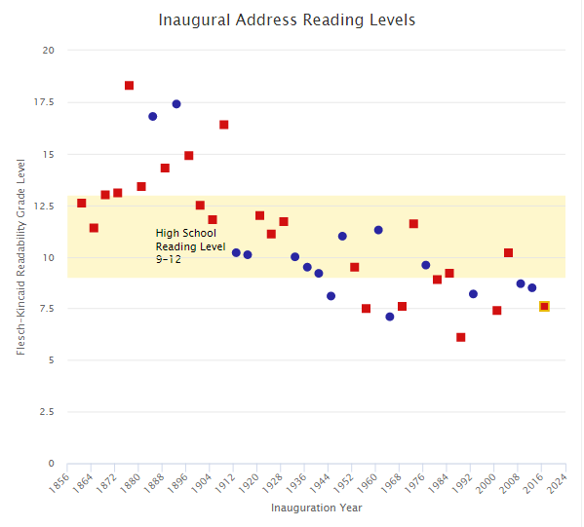
Accessible Narratives
Presidents’ inauguration speeches show a wide range of grade-level readability.
Notes:
Study analyzed presidents’ inauguration speeches to measure their “ grade level readability”. Red squares are republicans and blue circles are democrats. They range from over 18th grade with Rutherford B. Hayes to 6th grade for George HW Bush.
General rule of thumb is to keep readability level around the upper middle school to lower high school reading level. Consider recruiting students to help review your documents and ensure that they’re comprehensible for most audiences.

Slide 15
Translate Negative Data
In 2016, our program met the benchmark in 10 out of 15 program quality domains measured by the APT – compared to 11 out of 15 domains in 2015.
More Specific
Data show that our program provides a supportive environment for participating youth. In 2016, our program exceeded the benchmark in all 6 indicators related to this vital indicator.
More General
In 2016, our program maintained high levels of program quality, comparable to the last three years.
Translate to Improvement
2016 data findings suggest that our program excels particularly in Helping Youth Academically, but we have room for improvement in Youth Leadership. Based on this finding, our program will focus on the following steps for next summer: ____________.
Notes:
This example shows a common phenomenon – a slight dip in data one year compared to last year. But there are a number of different ways frame this data in a more positive light:
More specific – narrow in on a subset of indicators for which the data is more positive. For example, despite an overall dip in program quality, perhaps your org is continuing to excel in a particular bucket of domains
More general – this just one snapshot at one point in time. It may not be meaningfully different from previous years. If it’s similar to previous years, one could frame the data as “comparably high as the last few years” – which helps emphasize consistency, even despite changes in the program
Enumerate action steps to address this weakness next year. Be as specific as possible.

Slide 16
Lead with your Outcomes
Boston After School & Beyond convenes 158 program partners around shared goals and measures, coordinating data collection and evaluation across this network to quantify citywide reach and impact.
Boston After School & Beyond increases access to high-quality learning opportunities, partnering with 158 programs to help nearly 15,000 Boston youth develop the skills necessary for future success.
Notes:
Process is important – but always lead with the outcomes. When you need to be brief, outcomes always take priority over process
Ask yourself “the why” or the “so what”. Always lead with what’s in it for students.

Slide 17
Applying Strategies to Communication Materials Table Discussion

Slide 18
Table Discussion Activity
Reference your notes sheet
Identify strengths and weaknesses of each example based on the tips
Consider the magnitude of your suggestions
Be prepared to share out

Slide 19
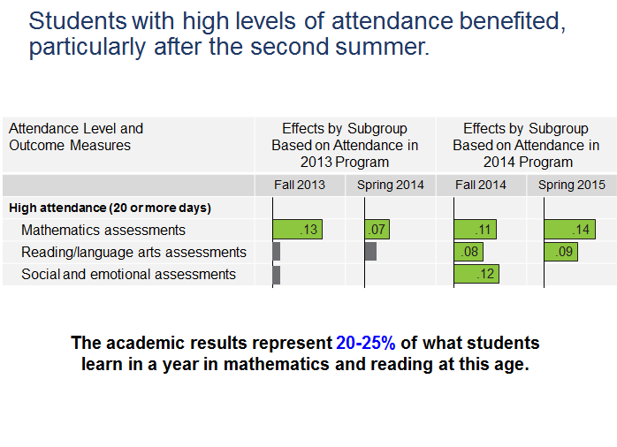
Notes:
Example 1

Slide 20
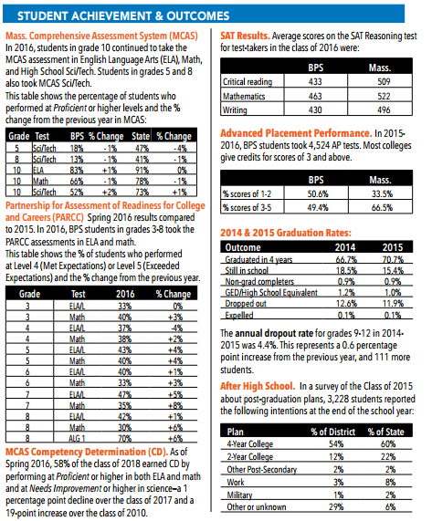
Notes:
Example 2

Slide 21
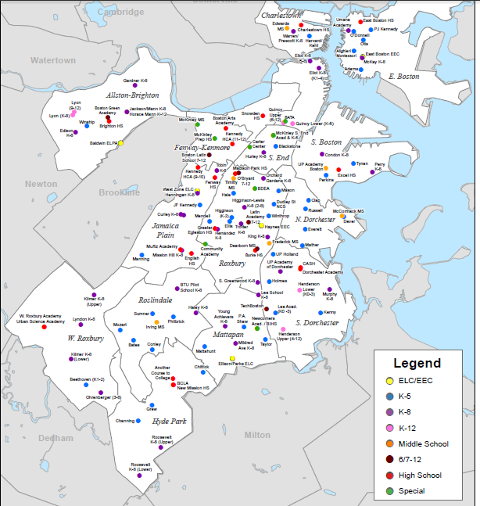
Notes:
Example 3

Slide 22
Notes:
Example 4

Slide 23
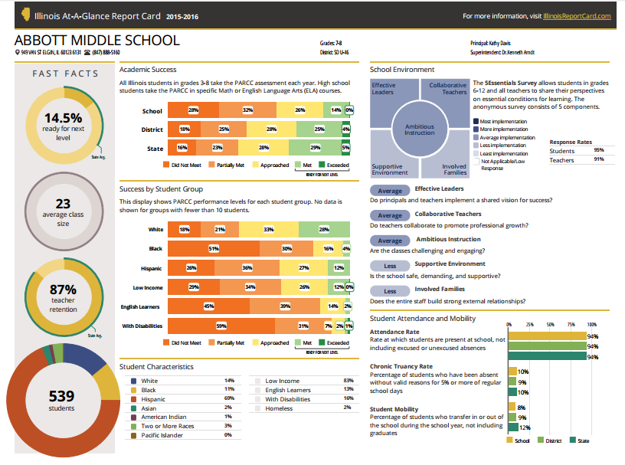
Notes:
Example 5

Slide 24
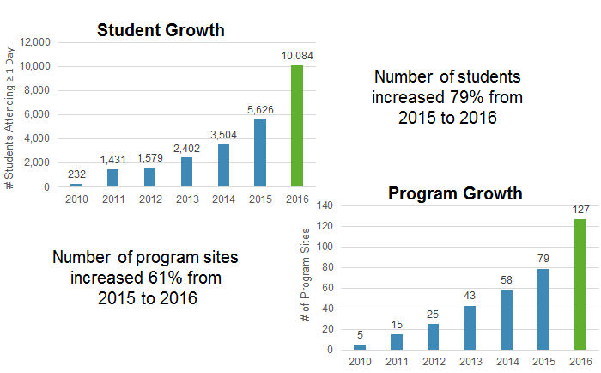
Notes:
Example 6

Slide 25
Boston After School & Beyond (BASB) is a public-private partnership that seeks to ensure that every child has the opportunity to develop to his or her full potential. BASB's role is to increase learning and skill development opportunities for students during the afterschool hours and summer months.
BASB advances student learning by mobilizing partnerships among program providers, philanthropy, business and higher education, the City of Boston, and especially the Boston Public Schools. BASB initiatives include summer learning, school-community partnerships, expanded learning opportunities for teens, STEM, and digital badging. Across its initiatives, BASB works with 117 organizations, 70 district schools, 10 funders, and local and national research organizations to expand quality learning opportunities for nearly 10,000 students in Greater Boston. The demographics of participating youth meet or exceed the need-level of populations served by the Boston Public Schools: 87% students of color, 27% English language learners, and 72% economically disadvantaged.
In order to expand high-quality summer learning opportunities for young people across Greater Boston, BASB facilitates partnerships between local program providers and district schools. In 2015, the SLP collaborated with 16 community-based organizations and 51 BPS schools to serve 837 high-need students in grades K-12. BPS certified academic teachers and community partner staff co-manage the programs, jointly developing and delivering academic and skill-building content and experiences for students. The SLP sets standards with common goals and shared evaluation, while allowing flexibility in program approach. All these opportunities allow students to apply content knowledge in hands-on exciting ways, empowering students to become life-long learners who are equipped for success in school, college, work, and life.
BASB complements the work of direct service providers by evaluating summer providers across common metrics and convening this rich network of programs around continuous improvement. During summer 2015, 63 additional summer sites that served 4,789 students implemented the same measurement tools as the SLP to assess program performance and student skill development. This unified network of 79 sites reaching 5,626 students – also known as the Boston Summer Learning Community – reflects the single largest expansion in the history of BASB’s summer learning work to date. Summer 2016 is already on track to exceed 2015 figures, with 100 summer sites across
Greater Boston expected to participate in the 2016 Boston Summer Learning Community.
Notes:
Example 7

Slide 26
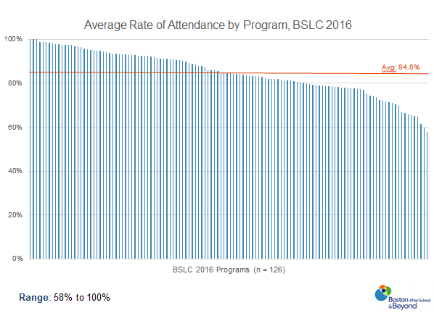
Notes:
Example 8

Slide 27
Notes:
Example 9

Slide 28
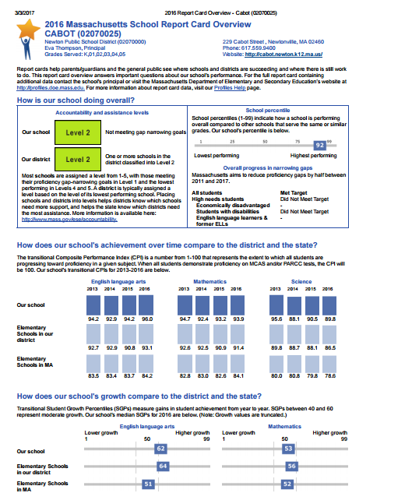
Notes:
Example 10

Slide 29
Break

Slide 30
Narratives for Various External Audiences Rotating Small Group Discussion

Slide 31
Sample Discussion Questions
Consider your specific audience and the examples provided:
What resonates with you?
What strategies do these examples use?
Does your program do something similar or different?
Notes:
Audience 1: Funders/Donors
Audience 2: Parents
Audience 3: Board Members

Slide 32
Sharing Out
What were the big takeaways for each audience?
How did the strategies compare across audiences?
What strategy are you most excited to apply to your communication?
What other resources or trainings would be helpful to you?
Notes:
Audience 1: Funders/Donors
Audience 2: Parents
Audience 3: Board Members

Slide 33
Process of Communicating Data
What tools are we using?
What do they measure?
What are the results?
What’s our plan for improvement?
Communicating the data to…
What data?
In what depth?
What medium?
What data?
In what depth?
What medium?
Board Members
Funders/
Donors
Parents
What data?
In what depth?
What medium?

Slide 34
Next Steps
Materials from this meeting will be emailed to attendees and posted on the Insight Center.
BASB is currently compiling a repository of research studies that can help make the case for your work and support your grant proposals. Anticipated release date: mid-April 2017. Examples of research themes include:
Benefits of summer and after-school
Importance of specific social-emotional skills, and practices that help cultivate these skills
STEM learning
If you have any questions or comments, please contact Danielle Kim, BASB’s Director of Policy and Communications: dkim@bostonbeyond.org or 617-345-5322 x280

