Slide 1
Summer Learning Community
Evaluation Results, 2014

Slide 2
Contents
Overview 3
Who did we serve? 11
Attendance 14
Program Quality
  Third party observer perspective 19
  Youth perspective 30
Student Skill Growth
  Teacher perspective 41
  Youth perspective 48
Impact of Training 57
Summary 60
Partners 61

Slide 3
Summer Learning Community
Overview
3

Slide 4

Boston Summer Learning Community
Professional
Learning Community
Citywide
Measurement Support
Summer Learning Project Sites
  18 sites in the Summer Learning Project (SLP), a school-community approach to integrated academic and enrichment content
  40 additional, citywide “aligned” sites -- with a variety of program models -- voluntarily adopted SLP’s approach to program quality measurement
4
Notes:
Done, read over.

Slide 5



Boston Summer Learning Community
Network of summer providers representing 58 sites in summer 2014
Implement common program quality measurement tools
Plan year round for ensuing summer, while addressing issues concerning student access to high quality summer learning experiences
Goals:
Increase Student Access to Summer Learning
Improve Quality of Programming
Scale & Sustain
Best Practices
5
Notes:
Done, read over 11/12.

Slide 6


Summer Learning Community 2014
30 organizations
58 sites
50 BPS Schools
3,504 students served
6

Slide 7
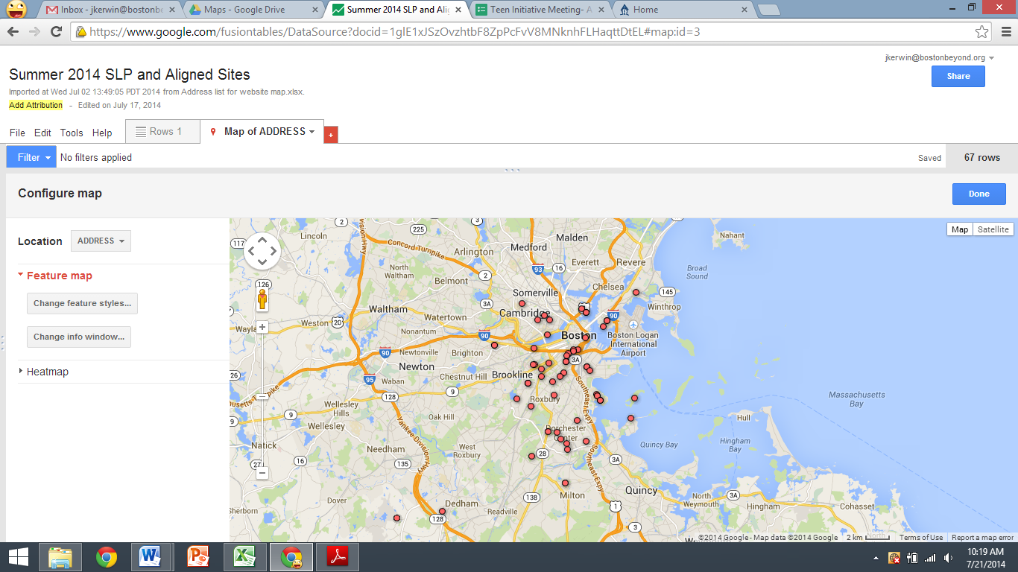
Summer Learning is Citywide
7

Slide 8
Summer Learning Community 2014
 | Summer Learning Project | Aligned Group | Mandatory Summer School
Description | a core group of providers working closely with BPS | a group of providers voluntarily implementing SLP evaluation tools | BPS partners with a community provider to offer academic remediation and enrichment
Targeted students | Low-income BPS students | Varies by program | High-need BPS students
Measurement Tools | SAYO Y, APT, SAYO T, HSA | SAYO Y and APT Optional: HSA | SAYO Y, APT, SAYO T
Organizations/ Sites | 16 providers; 18 sites | 17 providers; 29 sites | 1 provider; 11 sites
Students Served* | 681 | 2,045 | 778
*Students attending at least 1 day of programming.
8

Slide 9
Boston Summer Learning Community
Summer Learning Project
HSA
Measurement Tools
All programs implement tools to measure program quality from the third party observer (APT) and youth perspectives (SAYO Y).
All SLP and DMSS programs use a survey to assess student skill growth from the teacher perspective (SAYO T).
A subset of SLP and Aligned programs use a survey in which youth self-report their skill growth (HSA).
Aligned Measurement
SAYO Y
APT
SAYO T
District Mandatory Summer School
9
Notes:
Add title to this slide

Slide 10
Summer Learning Community Growth
2013
43 sites
2402 students
2014
58 sites
3504 students
Growth was driven by the addition of Aligned sites and Summer School sites.
10

Slide 11
Summer Learning Community
Youth Served
11

Slide 12
Who did we serve?
 | Summer Learning Community
Students | 3,504
Gender | 50.9% male 49.1% female
ELL | 30.4% current ELL*
Grades | K – 12th
*ELL status known only for SLP and Summer School youth
12

Slide 13
Who did we serve?
SLP
Aligned
White
White
Mandatory Summer School
White
Native American
13

Slide 14
Summer Learning Community
Attendance
14

Slide 15
Attendance
 | SLP | Aligned | Mandatory Summer School
Average Attendance | 78% | 91% | 77%
Program Attendance Range | 65% - 89% | 69% - 100% | 58% - 88%
Students attending less than 50% | 12.8% | -- | 11.2%
No Show Rate¹ | 26.1% | -- | 42.5%
Drop Outs² | 5.9% | -- | 4.9%
¹Calculation: (# students attending 0 days) / (# students recruited)
²Calculation: (# students attending 1-5 days) / (# students attending at least 1 day)
15
Notes:
BELL separate

Slide 16
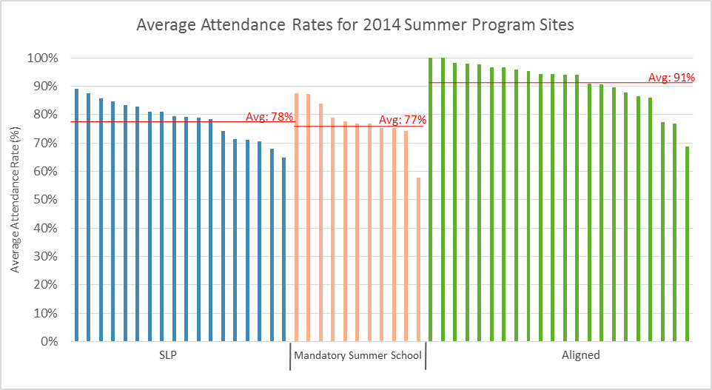
Differences in program type and in student population served should be taken into consideration when comparing attendance rates of the three program cohorts.
16

Slide 17
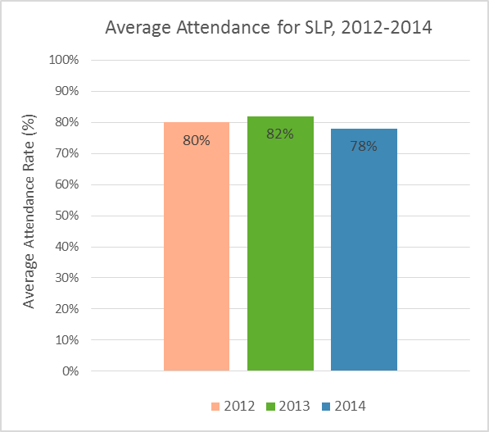
Attendance rates have remained fairly constant for the SLP cohort of programs across years.
17

Slide 18
Attendance: Items to Consider
What strategies can programs use to lower no-show rates?
How can programs ensure high attendance rates?
18

Slide 19
Summer Learning Community
Program Quality:
Third party observer perspective
19

Slide 20
Program Quality: Third Party Perspective
The Assessment of Program Practices Tool (APT) by the National Institute on Out of School Time (NIOST) is used by third party observers to rate aspects of program quality.
A score of 3 on a domain is considered the benchmark, meaning the quality practice is observed “most of the time.”
20

Slide 21
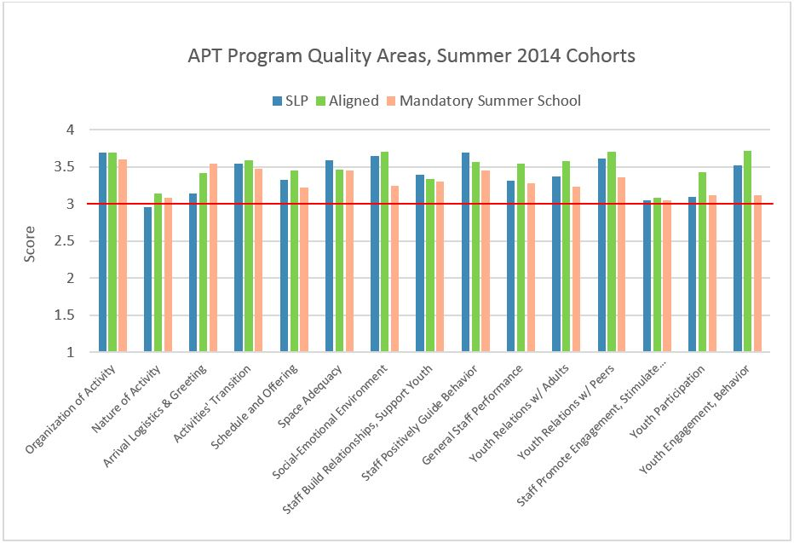
All three cohorts are performing just at or above the benchmark for all 15 domains.
21

Slide 22
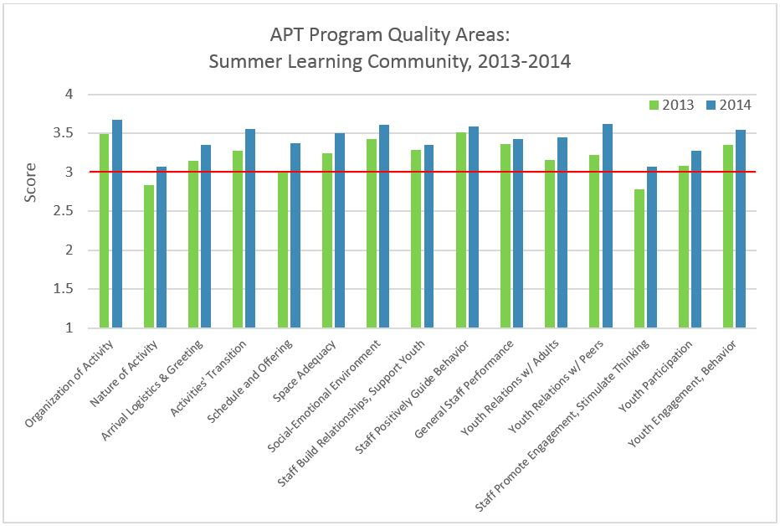
The 2014 Summer Learning Community is at or exceeding the program quality benchmark for all program quality areas measured by the APT, and has seen overall improvement from 2013.
22

Slide 23
Program quality results on the PRISM
To make the results more digestible for program providers, domains from the APT and SAYO Y are grouped into three broad categories on their program’s PRISM report:
  Program organization and structure
  Supportive environment
  Engagement in activities and learning
An “O” for “observer” indicates an APT item
A “Y” for “youth” indicates a SAYO Y item
23

Slide 24
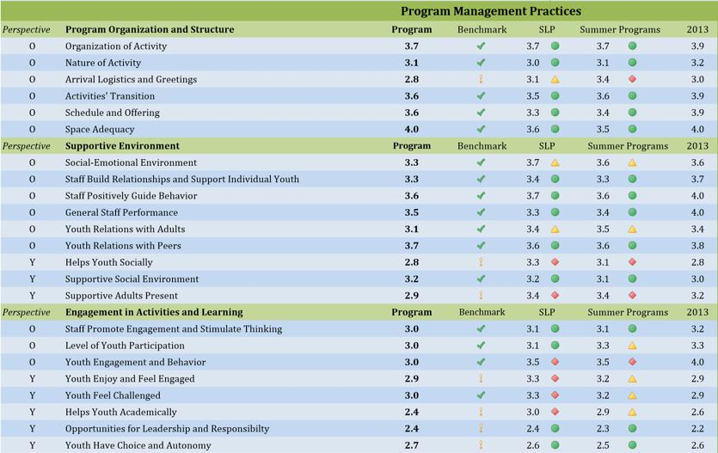
PRISM
An example of how APT results (indicated by an “O” for “observer”) and SAYO Y results (indicated by a “Y” for “youth”) are grouped into three categories on a program’s PRISM report. Comparisons to their cohort, all programs, and their prior years’ score are provided.
24

Slide 25
Highlighting APT Program Quality Trends
Heat maps were created to visualize the entire summer learning community’s data together (shown on the following slides).
Each row represents an individual program.
Dark green indicates the best score (4) and white indicates the lowest score (1). Gray indicates a missing value.
Areas of common strengths and challenges are easily identified, as well as programs performing well across the board. This information is used to inform Peer Learning Communities and Best Practice sharing.
25

Slide 26
APT:
Program Organization and Structure
Strengths:
  Organization
  Transitions
  Space adequacy
Room for improvement:
  Nature of activity
  Arrival logistics, greetings
  Scheduling/offering
26
Notes:
An overall average was created for each program; the heat map is ranked by this average. Dark green is good, white is bad, gray is missing. Red line marks benchmark of 3.

Slide 27
APT:
Supportive Environment
Most programs are performing strongly in this category.
Room for improvement:
  Staff build relationships and support individual youth
27

Slide 28
APT:
Engagement in Activities and Learning
More than half of programs are rated well in “youth engagement and behavior”
Room for improvement:
  Staff promote engagement and stimulate thinking
  Youth participation
28

Slide 29
APT Observer Program Quality Ratings:
Items to Consider
How can programs improve the nature, scheduling and offering of activities?
How can staff build better relationships with and support youth?
What are ways in which staff can promote youth engagement and participation?
29

Slide 30
Summer Learning Community
Program Quality:
Youth perspective
30

Slide 31
Program Quality: Youth Perspective
NIOST’s Survey of Academic and Youth Outcomes Youth Version (SAYO-Y) tool is a survey completed by youth at the end of their program that provides an essential youth perspective on program experiences and quality.
A score of 3 on a domain is considered the benchmark, meaning the youth thought the quality practice happened “most of the time.”
31

Slide 32
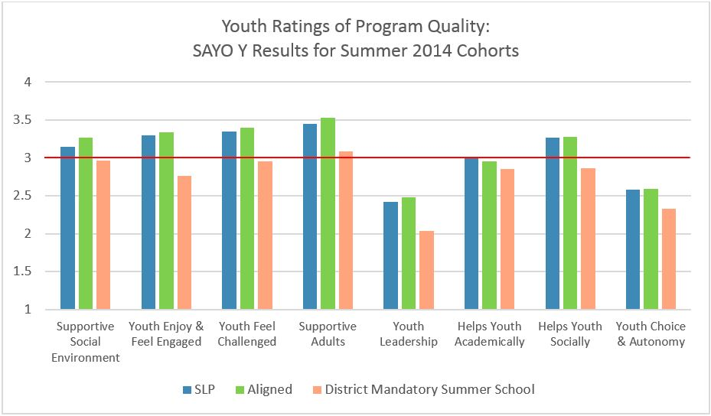
SLP and Aligned sites were rated similarly by youth, whereas District Summer School sites were rated lower. All three cohorts were rated low in “youth leadership” and “youth choice and autonomy.”
32

Slide 33
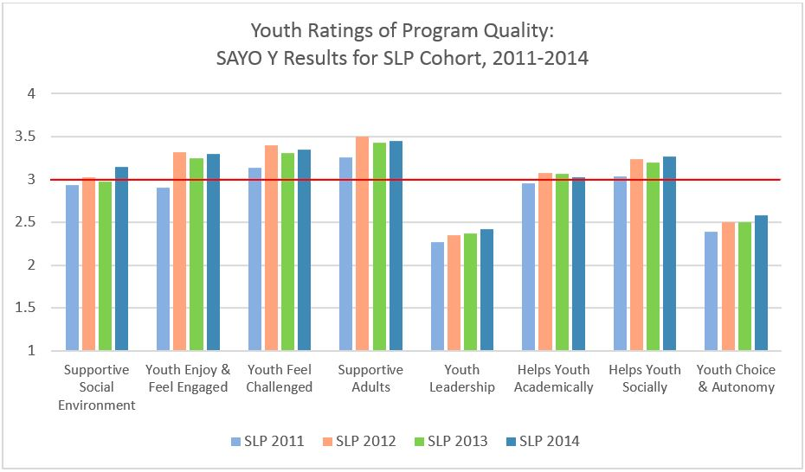
Over the past four years, the SLP cohort has been slowly but steadily improving in identified challenge areas of “youth leadership” and “youth choice and autonomy.”
This highlights the importance of continual measurement over multiple years to allow time for real trends to emerge, as opposed to slight yearly variations.
33
Notes:
Improvement over years, particularly in “youth leadership” and “youth choice and autonomy”; highlight importance of having 4 different groups of youth rate programs over time, and to see quality improvements

Slide 34
PRISM
An example of how SAYO Y results (indicated by a “Y” for “youth”) are grouped into three broad categories of program quality on a program’s PRISM report. Comparisons to their cohort, all programs and their prior years’ score are provided.
34

Slide 35
Highlighting SAYO Y Program Quality Trends
Heat maps were created to visualize the entire summer learning community’s data together (shown on the following slide).
Each row represents an individual program.
Dark green indicates the best score (4) and white indicates the lowest score (1). Gray indicates a missing value.
Areas of common strengths and challenges are easily identified, as well as programs performing well across the board. This information is used to inform Peer Learning Communities and Best Practice sharing.
35

Slide 36
SAYO Y: Supportive Environment
Youth rate programs as performing well overall
Room for improvement
  Helps youth socially
SAYO Y: Engagement in Activities
and Learning
Strengths:
  Youth feel challenged
Wide variation among sites in terms of youth thinking the program helps them academically
Room for Improvement:
  Opportunities for leadership and responsibility
  Youth have choice and autonomy
36

Slide 37
Observer versus Youth Ratings
For domains that measure similar concepts on the APT and SAYO Y, to what extent do youth and observers agree with one another on the program quality?
Plotting youth ratings against observer ratings on a scatter plot investigates this question (shown on following slides).
If youth and observers were in complete agreement, all dots would be along the diagonal line.
37

Slide 38
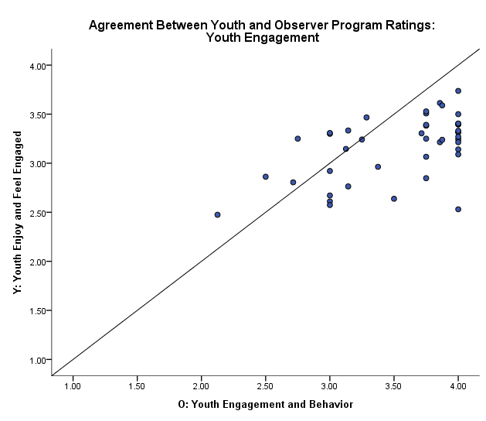
For programs that observers (x-axis) rate highly on youth engagement, there is wide variation in how youth (y-axis) rate the same program.
38
Notes:
Importance of taking into account the youth perspective.

Slide 39
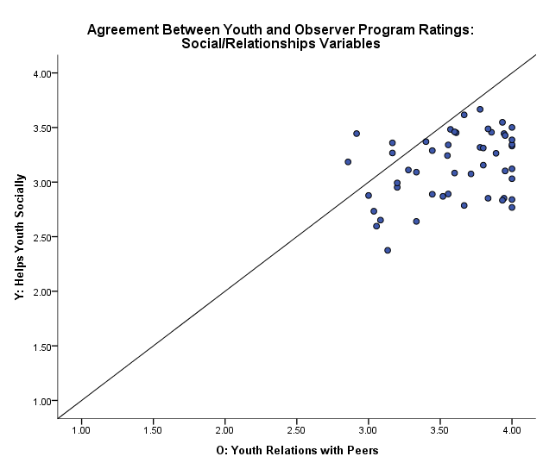
In general, youth rate programs lower than observers do. These two charts highlight the importance of taking into account the youth perspective.
39

Slide 40
Youth Program Quality Ratings:
Items to Consider
For programs that youth rate highly in terms of helping them academically, what are best practices that we can learn from?
How can programs balance organization and structure with providing youth opportunities for leadership and autonomy?
What are strategies for taking into account youth feedback on program quality?
40

Slide 41
Summer Learning Community
Student Skill Growth:
Teacher perspective
41

Slide 42
Teacher-Rated Student Skill Growth
NIOST’s Survey of Academic and Youth Outcomes Teacher Version (SAYO T) is a pre/post survey that allows teachers to rate students’ growth in certain academic and social-emotional skills and outcomes
42

Slide 43
Overall, teachers rated SLP students as significantly improved in all skills measured by the SAYO T.
43

Slide 44
Overall, SAYO T scores were similar for SLP in 2013 and 2014, with more variation for “Math” and “Initiative” between the two years. Variation between years is expected since each year programs serve a different group of students with unique and variable characteristics.
44

Slide 45
Students participating in the SLP have achieved significant skill growth every year, which indicates programs are of sufficient quality to contribute to skill growth. Variation in skill growth between years is expected since each year programs serve a different group of students with unique and variable characteristics.
45

Slide 46
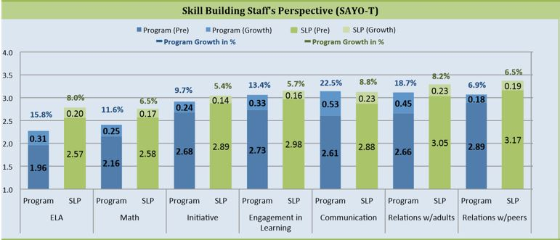
PRISM
An example of how the PRISM report shows how an individual program’s students compare to the average of all other programs in its particular cohort.
46

Slide 47
Teacher Rated Skill Growth:
Items to Consider
Main takeaway: on average, students are achieving significant growth in skill areas
Are there aspects of program quality that correlate with higher youth skill growth?
What instructional strategies impact youth skill growth?
How are attendance rates correlated to youth skill growth?
47

Slide 48
Summer Learning Community
Student Skill Growth:
Youth perspective
48

Slide 49
Student-Rated Skill Growth
PEAR’s Holistic Student Assessment (HSA) has two components:
  Diagnostic: students complete at the start of summer and rate their academic and social-emotional strengths and challenges
  Retrospective: survey completed by youth at the end of their programming in which youth self-report their growth in social-emotional outcomes as a result of participation in their program.
The HSA was administered at 10 sites (9 programs):
6 SLP and 4 Aligned
49

Slide 50
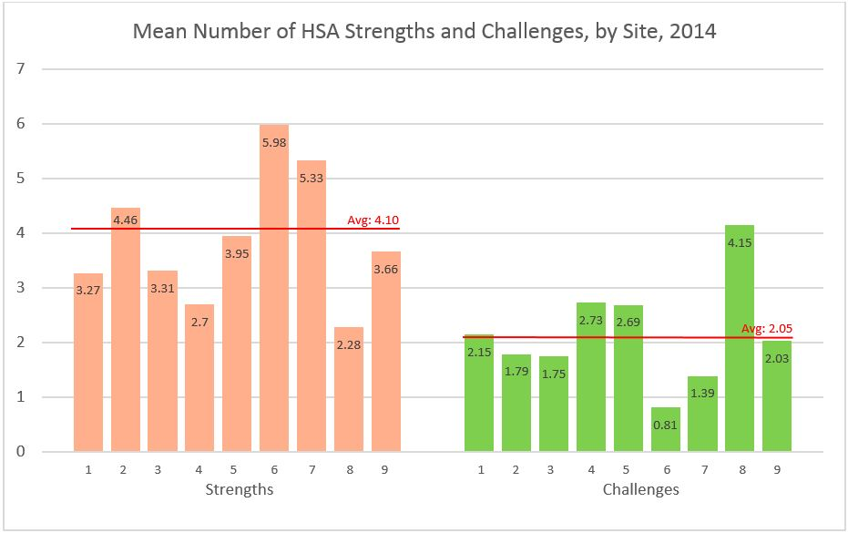
The social-emotional need level of students varied across sites, with students on average reporting more strengths than challenges.
50

Slide 51
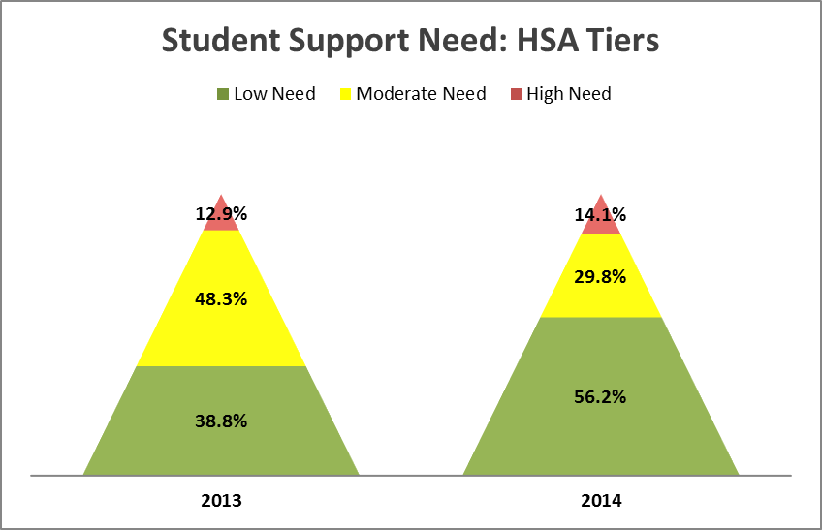
Based on the number of social-emotional strengths and challenges each student has, they are assigned to a “support need tier” which allows for a summative view of the overall social-emotional support need of a group of students.
The Summer Learning Community served more low-need students in 2014 than in 2013.
51

Slide 52
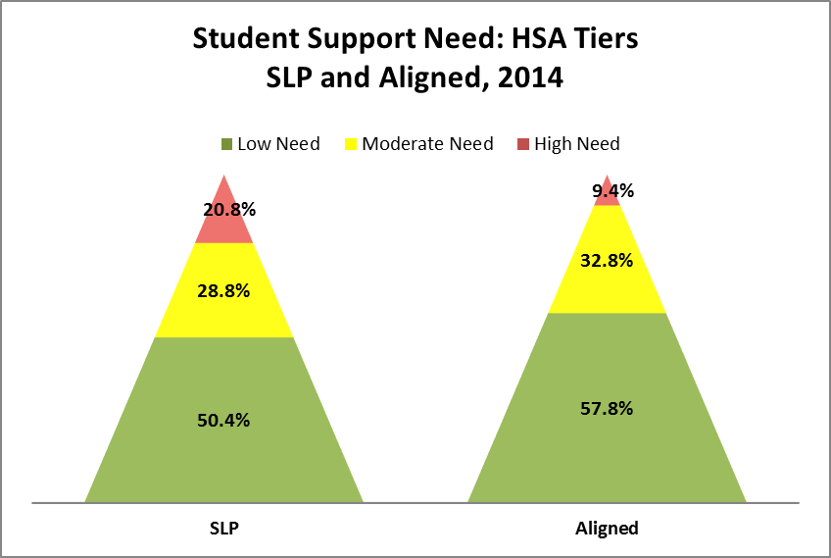
The SLP and Aligned programs served slightly different student populations in terms of social-emotional support need.
52

Slide 53
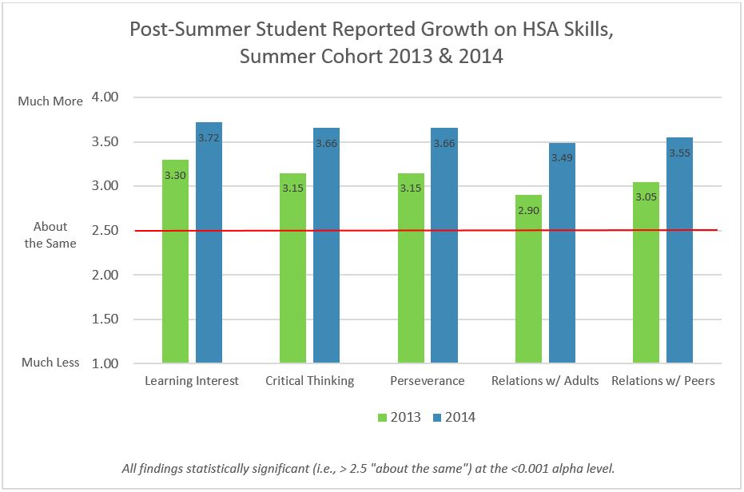
Students reported significant growth in all skills measured by the HSA at the end of their summer programming. Growth in all skill areas was significant in 2013 and 2014, although growth was higher in 2014.
53

Slide 54
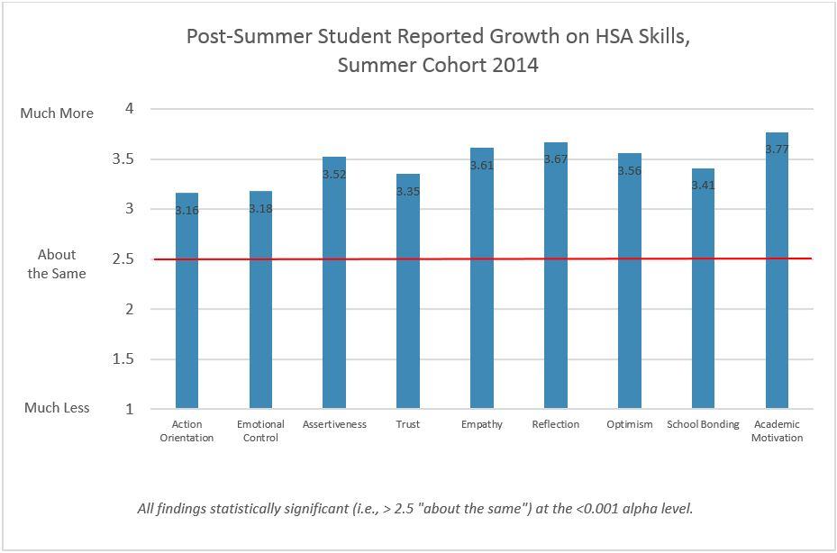
Students reported significant growth in 9 new skills measured by the HSA in 2014 at the end of their summer programming.
54

Slide 55
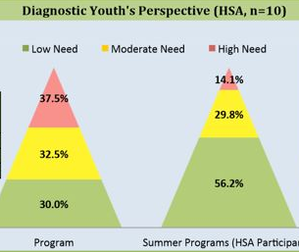
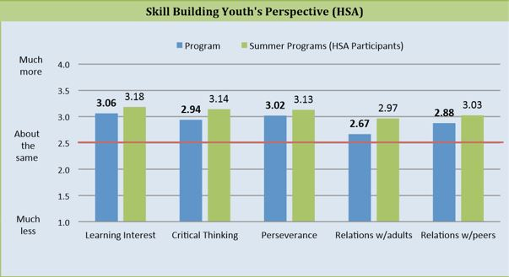
PRISM
An example of how the PRISM report shows how an individual program’s students compare to the average of all other programs in its particular cohort.
55

Slide 56
Student-reported skill growth:
Items to consider
Main takeaway: on average, students self-report significant growth in all skill areas as a result of participating in their summer programs
How do youth perspectives on program quality relate to youth-reported skill growth?
56

Slide 57
Summer Learning Community
Impact of Training
57

Slide 58
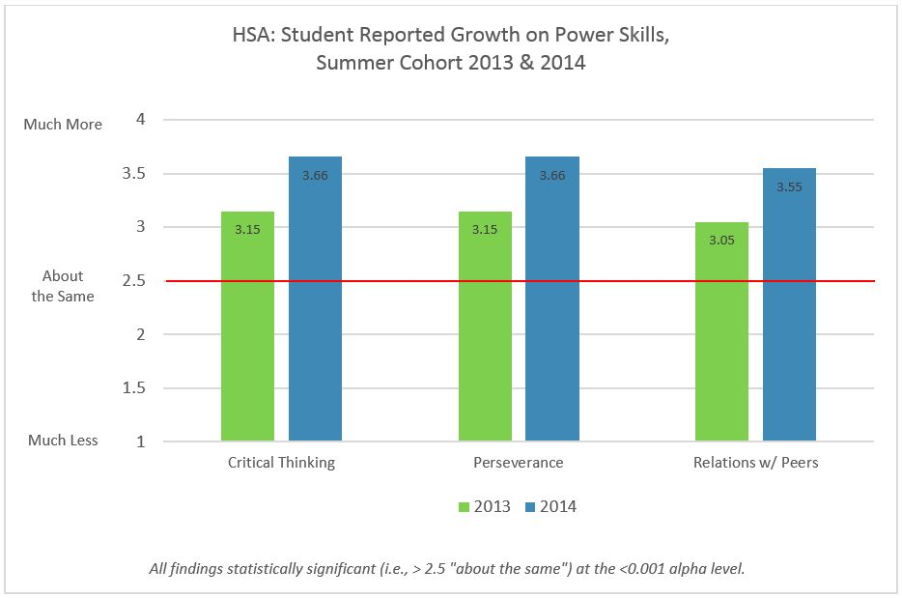
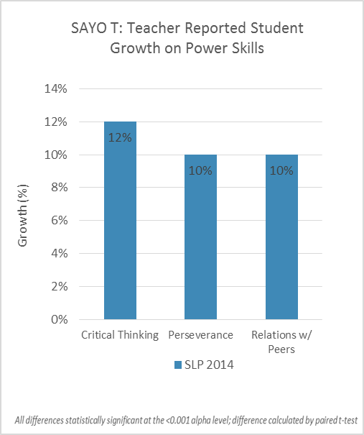
Power Skills
Critical Thinking, Perseverance, Relationships with Peers
Programs focused on how to help student development and growth in three power skills (critical thinking, perseverance and relationships with peers) during training workshops and peer learning communities leading up to summer 2014. As rated by students on the HSA and by teachers on the SAYO-T, students achieved significant growth in these three power skills during summer 2014.
58

Slide 59
Program Improvements Across Years
 | % of Programs who maintained or improved scores (2013 – 2014)
O: Arrivals & Logistics | 45%
O: Activities’ Transitions | 67%
O: Relationships w/ Peers | 67%
Y: Youth Leadership | 48%
Y: Youth Choice & Autonomy | 61%
One half to two-thirds of the programs with data from both years (n = 22 to 24) either maintained or improved their scores in 2014 in program quality areas that were topics of summer planning sessions.
59

Slide 60
Summary
Programs overall have good attendance rates: what can we do to boost these and lower no-show rates?
There are aspects of program quality that as a cohort we are excelling in, and areas where we can all learn from one another to improve as a group.
Focusing on youth engagement, participation, leadership and choice should be a priority for all providers.
Both teachers and youth report significant student growth in skill areas (most notably the power skills). How can we use our peer learning communities to learn best practices in skill development?
60

Slide 61
Our Partners
Summer Learning Project
Boston Private Industry
Council
Boys & Girls Club of Boston
Courageous Sailing
Boston Family Boat Building
Dorchester House
Freedom House
Hale Reservation
Hyde Square Task Force
IBA
MathPOWER
Sociedad Latina
Sportsmen’s Tennis & Enrichment Center
Tenacity
Thompson Island Outward Bound
USS Constitution Museum
YMCA of Greater Boston
Aligned Measurement
Boston Area Health Education Center
Boston Private Industry
Council
Boston University
Brigham & Women's Hospital
Camp Harbor View
Community Music Center of Boston
Courageous Sailing
Crossroads for Kids
Horizons at Dedham Country Day
Joseph M. Tierney Learning Center
MIT, Office of Engineering Outreach
Phillips Brooks House Association
Piers Park Sailing
Sportsmen’s Tennis & Enrichment Center
Steppingstone Foundation
UMass Boston
YMCA of Greater Boston
BPS Mandatory Summer School
in partnership with BELL
61

