Slide 1
Gil G. Noam
Presentation at ____
On _____
MISSION:
The Program in Education, Afterschool & Resiliency (PEAR) is a joint initiative of McLean Hospital and Harvard University. PEAR partners with school districts and youth-serving organizations to promote socio-emotional development in the service of student engagement, academic achievement, and life success.

Slide 2
Domains to Increase Student Engagement
Mental Health
Socio-emotional
21st Century Skills
(e.g., Persistency, Collaboration, Self-management)
Resilience in Face of Adversity
Mental Health
(e.g., Depression, Trauma)
Resilience in Face of Adversity
Socio-emotional
21st Century Skills
Prevention
Intervenion

Slide 3
Socio-Emotional Development and Engagement and Attendance
Academic achievement, school attendance and student engagement are tied to socio-emotional skills.
Positive relationships between adults and peers increase resilience and academic perseverance.
Recognition of developmental strengths is as important as recognition of challenges.

Slide 4
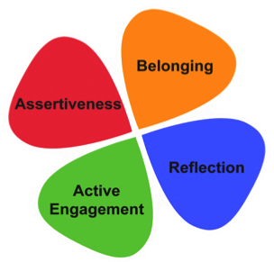
Clover and Power Skills
Leadership and Perseverance
Cooperation and Empathy
Self-management and Emotion control
Critical thinking and
Self-awareness

Slide 5
Key Times for “Specialization”
Middle Childhood
6-10
Early Adolescence
11-15
Belonging
Assertiveness
Reflection
Active
Engagement
Full
Adolescence
16+
Pre-School
0-5

Slide 6
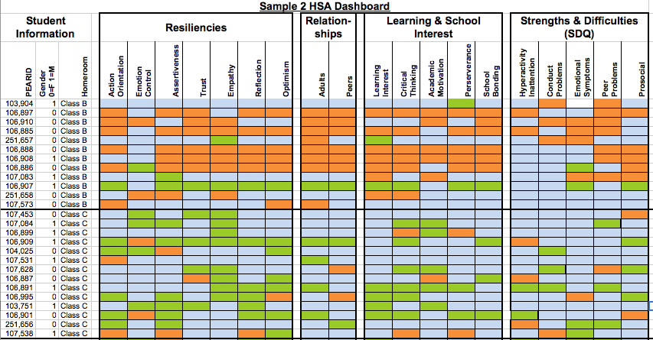
Knowing Every Classroom: Identifying the Strengths and Challenges
Assessment:
Classroom
HSA Classroom Dashboard
Class B contains students with many challenges
Class C contains students with many strengths

Slide 7
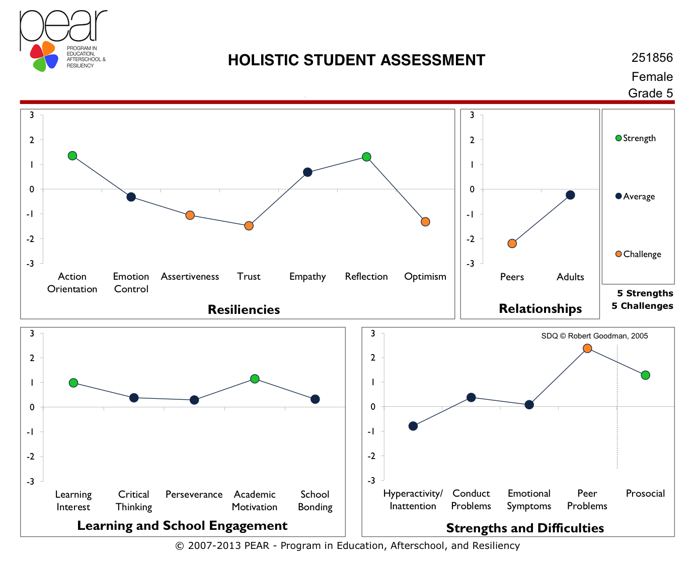
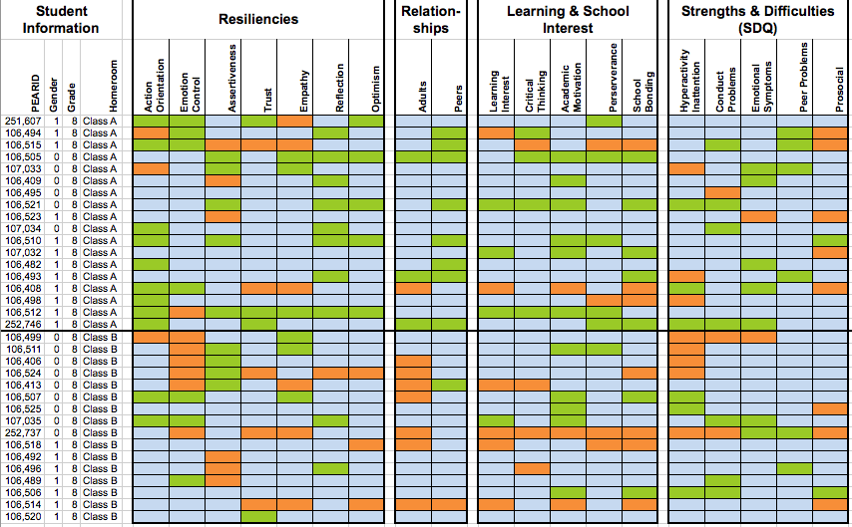
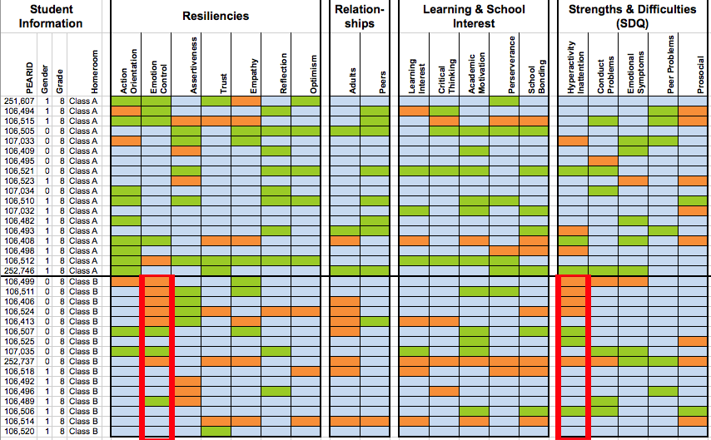
From Assessment to Intervention
Fall 2015 HSAs
HSA Classroom Dashboards
Emotion Control
Hyperactivity/Inattention
Intervention Generator
Intervention Generator

Slide 8
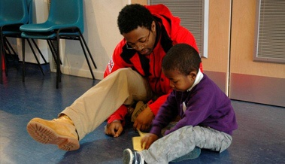
From
Hyperactivity to
Active Engagement
Walk and Talk
Academic Learning with Physical Action
Special Task in Classroom
Recess, learning Management Skills
Routines with Energizers

Slide 9
For More Information
Gil Noam, Ed.D. Ph.D. (Habil)
Director
gil_noam@harvard.edu
617-484-0466 x201
www.pearweb.org

