Slide 1
Welcome!
NonProfit Center, 89 South Street
March 17, 2017
9:00 AM – 10:00 AM

Slide 2
Introductions
What’s one thing that is special about your program?

Slide 4
Agenda
BASB’s Approach: Boston Learns Together
Opportunities and Skills
A Coordinated & Measurable Citywide Network
Measures that Matter
Program Performance
Youth Outcomes
The PRISM Report
Next Steps
Key Dates
Process for Joining the BASB Network

Slide 5
The Achieve, Connect, Thrive skills enable success in school, college, and careers.
ACT Skills Framework
ACHIEVING | Critical Thinking
 | Creativity
 | Perseverance
CONNECTING | Social Awareness & Relationships
 | Communication
 | Teamwork
THRIVING | Growth Mindset
 | Efficacy
 | Self-Regulation

Slide 6
There is a gap in opportunities to build knowledge, skills and experiences…

Slide 8
The diverse needs & interests of youth require a an equally diverse citywide approach.

Slide 9
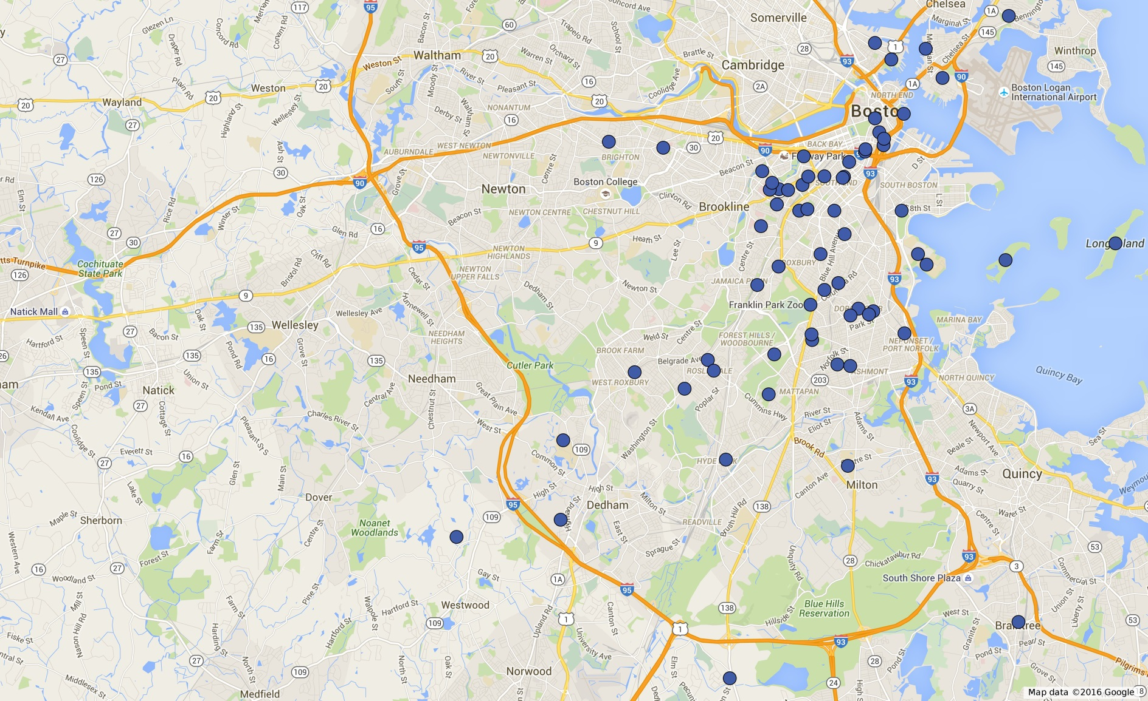
Expanding the Classroom to the Community (2016 Summer Learning Sites)

Slide 10
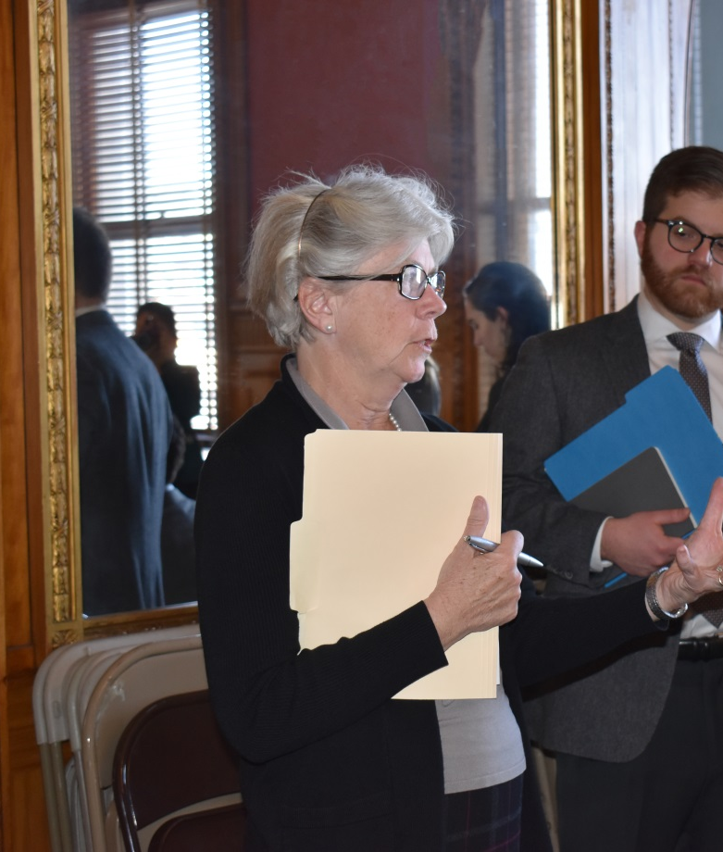
This network has created new ways of reaching young people and enhancing their work.
New evidence
New models
5th Quarter
BoSTEM
Badging
SEL
New funding & Policy
Boston Public Schools RFS for summer learning
An Act to increase access to high quality summer learning opportunities

Slide 11
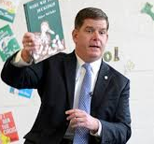
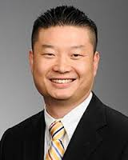
Public leaders embrace a coordinated approach.
“When we use our city as a classroom, we put young people on a path to success and build a stronger city for everyone.“ -- Mayor Martin J. Walsh
"To create a system that guarantees a vibrant, whole-child education beyond the walls of the classroom, it's going to require systems to be created. A system requires data tracking.” -- Superintendent Tommy Chang

Slide 12
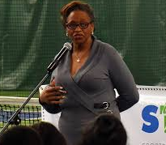
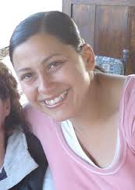
Partners see the benefits of working together.
“Everything that we learn – whether it is about resiliency or how we’re connecting with kids – we apply to our programs. The data help us improve and help our partners see the value we bring.“ -- Toni Wiley, Sportsmen’s Tennis & Enrichment Center
“Boston After School & beyond shines a light on the quality work that community based organizations are doing and helps us grow by sharing best practices and data on improving student skills.” -- Alex Oliver-Davila, Sociedad Latina

Slide 13
Measures that Matter

Slide 14
Measuring Program Performance & Youth Outcomes
Badging
10 programs
Award digital badges in growth and achievement in ACT skills
Youth Outcomes
94 programs
Administer teacher assessment and/or youth self-assessment in ACT skills
Program Quality
171 programs
Undergo third-party observation and administer youth survey
Attendance
183 programs
Track youth participation in city-wide database, Cityspan

Slide 15
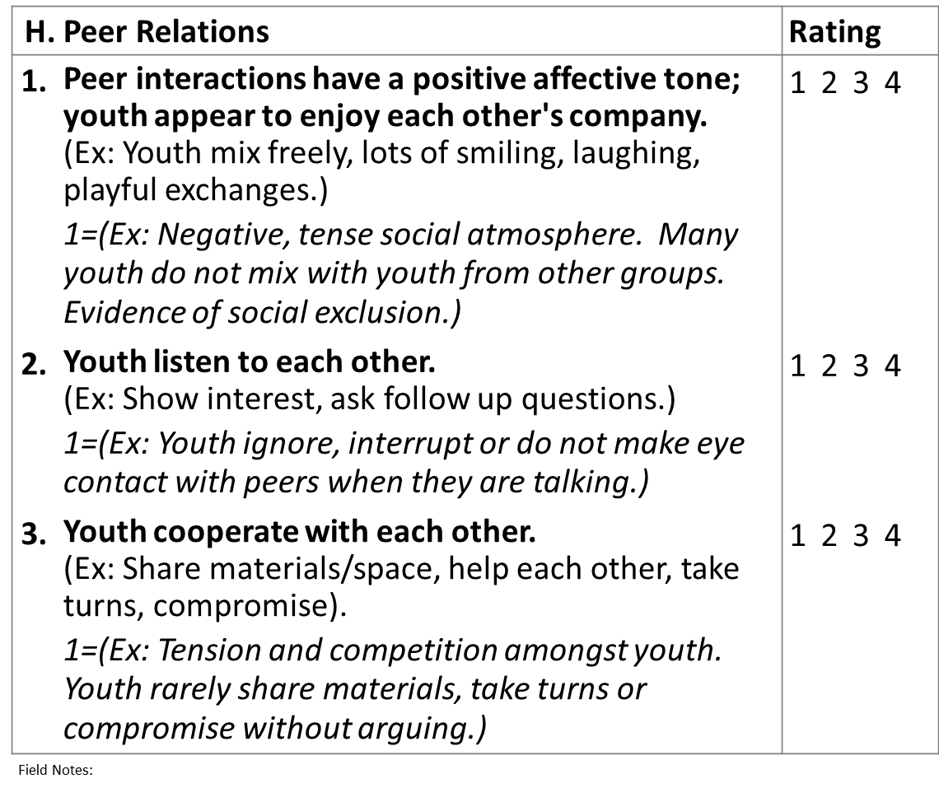
BASB Observer Certification
1) Train to use the APT in a program setting.
3) Observe and assess fellow youth-serving programs.
2) Receive a BASB Certificate in program observation.
CERTIFICATE
Benefits:
Access a validated tool to assess your own program
See best practices in action throughout Boston
Network with fellow professionals in the field
Notes:
Do we have a photo of this?

Slide 16
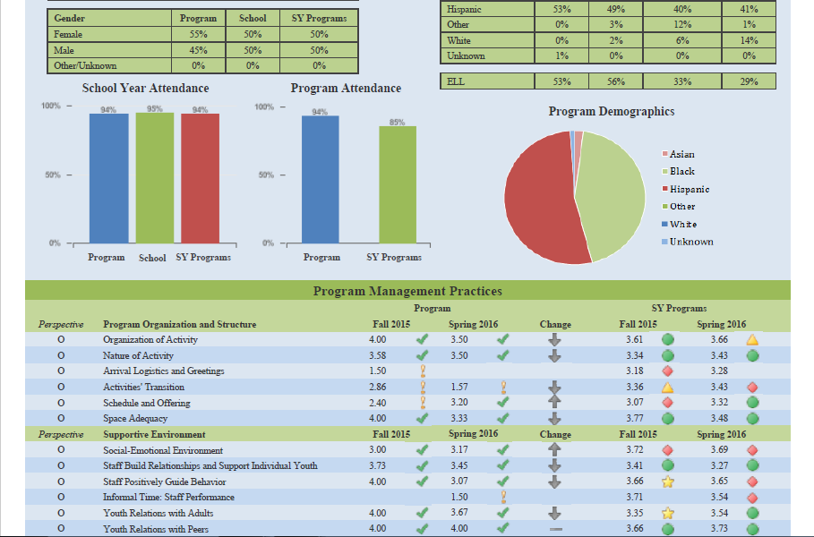
Reporting Program Data: The PRISM
Your own program’s performance vs. quality benchmarks.
How your program compares to the network.

Slide 17
Next Steps
Late April/
Early May
Spring Observer Certification Training
Location TBD
A two-day intensive training in the use of the Assessment of Program Practices Tool (APT). Attendees will learn and practice how to effectively use the tool to observe and assess youth-serving programs. At the end of this training, attendees will be certified as BASB Program Observers, and may observe and assess fellow youth development programs in BASB’s network.
May 23
Measurement Orientation
NonProfit Center, 89 South Street, Boston
10:00-12:00
New summer program partners are highly encouraged to attend this event. BASB’s Data Team will provide an overview of the measurement tools used in evaluating programs in BASB’s network. Additionally, programs will understand the logistics of implementing these tools in the own program.
June 5
ACT Skills Summit
Boston University
8:30-3:30
Professional development on skills in preparation for summer 2017 and school year 2017-18 programs.

Slide 18
Questions?
Thank you for coming! Please stop by the table on the way out to indicate your interest in participating in our network.

