Slide 1
Maximizing Student Attendance in Summer Programs January 27, 2017
Notes:
Done, read over.
Give table tents to Julia morning of.

Slide 2
Evidence Base for Student Attendance
Notes:
Done, read over.
Let’s start off this morning with the ‘why?’ Why are we focusing on student attendance? Well, there is an emerging evidence base for student attendance. Let’s start off with what we know qualitatively. Intrinsically, we all know that students must attend to benefit from our programs. It’s a belief that drives our year-round planning for summer and our focus on this topic.
But now our qualitative beliefs match what research is telling us.
Katie Tosh from our team will talk more about this soon in the context of a larger research base, but the recent RAND research on summer learning – using the gold standard in research, a randomized controlled trial - tells us that students with high attendance benefit from their participation. That gives us reassurance that programs that meet high quality conditions can benefit high attenders, but it also it places a renewed focus on ensuring students attend regularly. And that’s not always the easiest thing to accomplish in summer.

Slide 3
Maximizing summer student attendance is a year-round effort related to many realms of program design.
Family engagement
Staff/teacher hiring
School-CBO Partnerships
Student registration
Purposeful program activities
Staff training
Program culture/core values
Routines and rituals
Positive relationships
Notes:
Done, read over.
For the how, we know maximizing student attendance in summer is not accomplished through one task or attained in a singular point in time. Rather, it’s a year-round effort that directly relates to many aspects of program design that you probably are in charge of: partnering with schools to register students, engaging families, training your staff to work with students, designing your program activities to challenge and support students. All of these items ultimately feed in whatever your attendance percentage is at the end of a given summer.

Slide 4
Key Themes
Setting clear goals around consistent attendance - with students, families, and staff
Developing a warm, caring program climate that intertwines fun, learning, and positive relationships
Implementing a culture of high expectations among staff, students, and families
Notes:
Done, read over, and consistent with planning doc.
---
In the fall, we set out to understand how certain programs maximize summer student attendance. We sat down with IBA Boston (which serves elementary school students), the Achieve program (which serves middle school students), and Camp Harbor View (which, among other age groups, serves high school students) because they notched some of the highest student attendance rates in summer 2016. Interviews with these organizations can be found on our Insight Center.
Several key themes emerged from these best practice interviews. You can see them here. Now, let’s be blunt: We can’t pretend these themes are the answer to any particular program’s attendance woes. And it’s much easier to write these themes on a PowerPoint slide than it is to enact them. But it’s the start of a conversation that can hopefully inform citywide best practice.
An example of the first theme– setting clear goals – is the Achieve program’s family attendance contract, which is available for download on our Insight Center.
IBA Boston’s program utilizes an essential question – “What is community?” – and a project-based learning curricula to hit on the 2nd theme – fun, learning, and positive relationships.
Last but not least, at Camp Harbor View, a set of core values and weekly supervisory meetings among staff and employed teenagers set the stage for a culture of high expectations.

Slide 5
Our Facilitators
Shannon Hayes
Afterschool & Summer Learning
Program Coordinator
Nora Dowley-Liebowitz
Executive Director
Meghan Kelleher
Graduate Services Coordinator
Greg Stoddard
Executive Director
Notes:
Done, read over.
To help us unpack, understand, and apply these themes to our work, we’re excited to have representatives from these three organizations joining us here today. They’ll be leading much of the discussion today.
From IBA Boston, we have Shannon Hayes
From Achieve, Nora Dowley Liebowitz
And from Camp Harbor View, Mr. Greg Stoddard.

Slide 6
Agenda
9:50am
10am
10:40am
11:30am
Recap of data findings from summer 2016
Katie Tosh (Boston Beyond)
Conversation/Q+A with program leaders
Featuring Shannon Hayes (IBA), Nora Dowley-Liebowitz (Achieve), & Greg Stoddard (Camp Harbor View)
Roundtable Discussions, by age group served
Closing Reflections/Next Steps
Notes:
Done, read over, consistent with planning doc.
---
That leads us nicely into our agenda for this morning. In a moment, I’ll hand it over to Katie Tosh, who will provide a recap of findings from last summer in relation to student attendance. Then, we’ll bring up our featured program leaders to hear more from them about the three themes and open it up for some questions from you all.
We’ll then transition into roundtable discussions about the themes, and these roundtables will be facilitated by our three featured program leaders.
We’ll close out the morning with reflections and next steps.
Hand off to KT.

Slide 7
Katie Tosh Boston After School & Beyond
Notes:
Done, read over.

Slide 8
Students with high levels of attendance benefited, particularly after the second summer
Attendance Level and Outcome Measures | Effects by Subgroup Based on Attendance in 2013 Program |  | Effects by Subgroup Based on Attendance in 2014 Program
 | Fall 2013 | Spring 2014 | Fall 2014 | Spring 2015
High attendance (20 or more days)
Mathematics assessments
Reading/language arts assessments
Social and emotional assessments
.13
.07
.
1
1
.14
.08
.09
.12
The academic results represent 20-25% of what students learn in a year in mathematics and reading at this age
Notes:
Patter: explain why not presenting effect sizes, also explain meaningfulness of of effect sizes
Explain inability to piece apart the 2 summer versus improved experience
High is at the top, low, then no show. Build: 1) high summer 2013 2) all categories 2013 3) high summer 2014 4) all categories 2014

Slide 9
The RAND study on summer learning found significant advantages in math, ELA, and social-emotional skills for high attenders (≥ 20 days). Two factors are at play here: duration of program and retention of students in the program. The above graph is for all BSLC students, regardless of program duration. However, among students who were scheduled to attend at least 20 days, 70% of those students attended 20 or more days of summer programming.
Notes:
We learned in the RAND presentation this morning that we need to start looking beyond average rates of attendance and consider the dosage of programming which students are receiving. Our programs on average were 6.5 weeks long, ranging from 1 to 10 weeks. What we’re looking at here is the percent of students by the number of program days which they attended. You’ll see our drop outs there on the end, 6%, who attended five or fewer days, and then students who attended up to 54 days all the way at the other end of the spectrum. The majority of students fall into the 11 to 30 day range, though.
Importantly, 60% of students attended 20 days or more of programming, regardless of duration of programming. If we look at only students who were scheduled to attend at least 20 days, we find that 70% of those students ended up attending at least 20 days. So we know that two factors are at play here: duration of program and retention of students in the program. We’re not suggesting that shorter programs change their model to be longer. The point is to utilize the time you have with students wisely to ensure they have the best chance at benefitting from being in your program, and employ strategies to make sure students show up and keep coming throughout the summer.

Slide 10
Avg: 84.8%
Range: 58% to 100%
Notes:
Here we can see how the average rate of attendance varies across programs. Each bar represents a program, and the range of attendance goes from 58% on the low end to 100% on the high end (those are overnight camps). Our average rate of attendance is sitting at 84.8%. The majority of programs fall pretty close to the average, but there is a subset of programs whose attendance rate falls below 80%, so attendance and retention strategies could be of greater importance for those programs to focus on in the upcoming year.
Make note of consistent ARA for SLP programs since 2012 at 80% to 80% in 2016, with slight fluctuations in between.

Slide 11
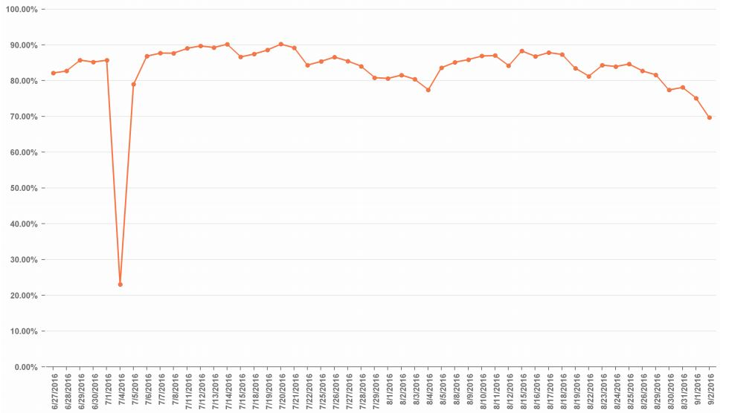
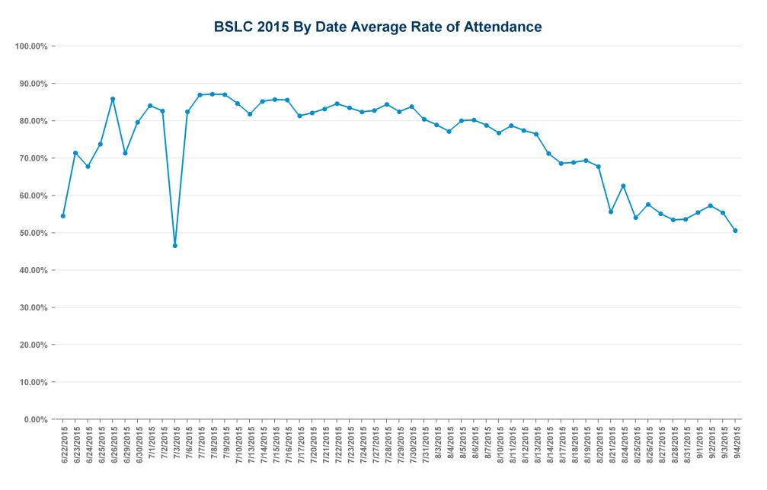
BSLC By Date Average Rate of Attendance, 2015 and 2016
July 3, 2015
July 4, 2016
2015 dates
2016 dates
2015 by date average rate of attendance
2016 by date average rate of attendance
Notes:
Lastly on attendance, we can look at the by date average rate of attendance. This is last year’s data. We saw that attendance was slow to pick up for programs that started at the end of June, and saw that attendance trailed off as we got towards the end of summer. We also saw a drop in attendance on the Friday of July 4th weekend, which was July 3rd.
Overlaying 2016 data on top, we can see some differences. First, the line overall is higher, reflecting better attendance and student retention in the programs. We notice the slow uptick in attendance at the start of the summer wasn’t as prominent, but also that programs started a few days later this year. We can also see that the drop off in attendance at the end of the program is pretty similar to last year. Although our overall attendance rates are higher, the slope of these two lines is similar, so the trend is still occurring even with higher rates of attendance on those days. We also see a much bigger drop in attendance for the holiday weekend because July 4th fell on a Monday this year.
For attendance, keep in mind: good recruitment efforts so that students who sign up for the program are coming and not dropping out, strategies to ensure students become high attenders, and that students attend throughout the entire summer.

Slide 12
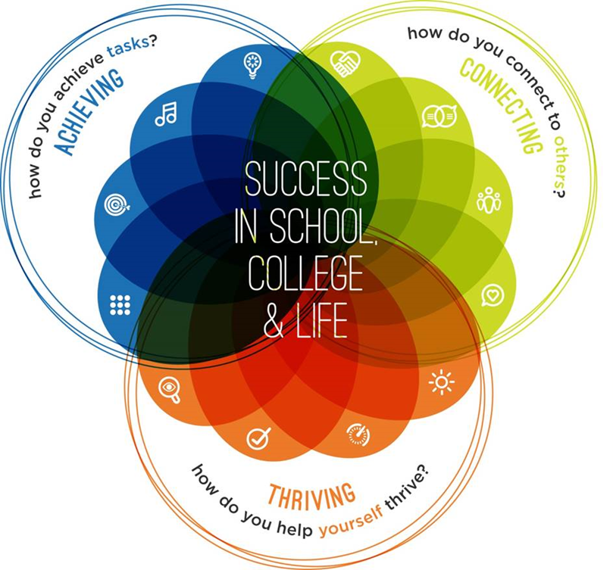
66% - 91% of programs hit the benchmark of quality practice, depending on which skill the practices are meant to build
38% - 76% of youth hit the benchmark of skill demonstration, depending on the skill

Slide 13
Key Themes
Setting clear goals around consistent attendance - with students, families, and staff
Developing a warm, caring program climate that intertwines fun, learning, and positive relationships
Implementing a culture of high expectations among staff, students, and families
Notes:
Done, read over, and consistent with planning doc.
---
On screen as panel begins. Panelists each have table tent with name on it, so don’t need their names up here.

Slide 14
Group Discussion Questions
Setting clear goals around consistent attendance - with students, families, and staff
What expectations around attendance - implicit or explicit - do you currently set with students, families, and staff?
Based on the discussion thus far, what ideas do you have for summer 2017?
Developing a warm, caring program climate. Intertwine fun, learning, and positive relationships
What routines and rituals did you have in place in summer 2016 to build positive relationships among staff, students, and families?
Based on the discussion thus far, how should programs balance structure, relationships, and fun?
Implementing a culture of high expectations among staff, students, and families
What are your program’s core values - explicit or implicit - and how do you make those expectations clear to staff and students?
Based on discussion thus far, how can adults and students work together to set high expectations within a supportive environment?
How should your program engage students in critical thinking and problem solving?
Notes:
Done, read over. Consistent with 3 themes, and planning doc.
------
Thanks Shannon, Nora, and Greg.
We hope you’ve enjoyed hearing about the approach IBA, Achieve, and Camp Harbor View take to maximizing student attendance, in alignment to the three themes.
Luckily for us, Shannon, Nora, and Greg will continue to drive conversation around these three themes. Over the next couple minutes, we’ll split into break out groups based on age group served – preK-5 (elementary), middle school, and high school. Here are the discussion questions that will guide your group’s conversation. As you can see, these are based on the three themes we’ve discussed so far this morning.
On your way in, you received a handout that covers the 3 themes and encourages you to start thinking about what your program should keep, what it should change, and what it should start doing as a result of your reflections today. And each theme is broken into areas that many of you are probably in charge of for your program: student/family engagement, staff training and prep, and program content. We hope this handout is useful during the small group discussions. This is for you to fill out at your own pace and to keep. We won’t collect these.
So, without further ado, let’s split into groups by age group served. If you look at your nametag, you’ll find your table assignment. If you don’t have a table assignment, it means your program serves a wide grade span and we wanted to give you flexibility to choose.
Now, with all this said, we encourage programs to give youth choice and autonomy, right? So if you disagree with your table assignment or if there are multiple people from your organization here and you want to divide and conquer, please feel free to choose the table that is right for you.
[Point out tables – age and facilitator. XX, we’ll have you here to facilitate conversation with those who serve elementary . Julia places table tents accordingly.]
We’ll come back together in a bit to report out how each of your conversations goes. With the next few minutes, please find your table and we’ll start the conversations. Thank you.

Slide 15
Next Steps
Notes:
Kelsey Cowen.

Slide 16
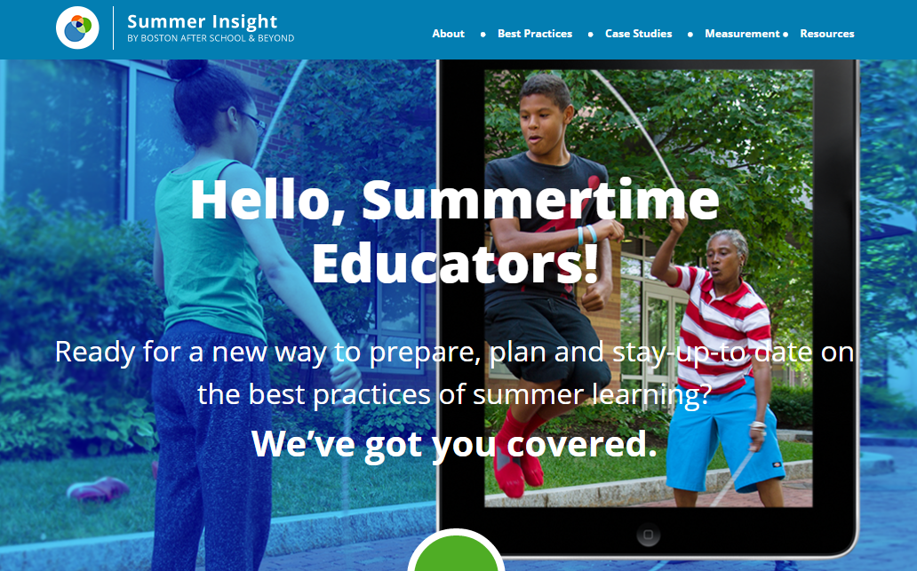
1
Check out the Insight Center for more best practices
summerinsight.bostonbeyond.org
Notes:
Click on image to be taken to the Insight Center. Show Attendance Best Practices, Events, and Measurement pages.

Slide 17
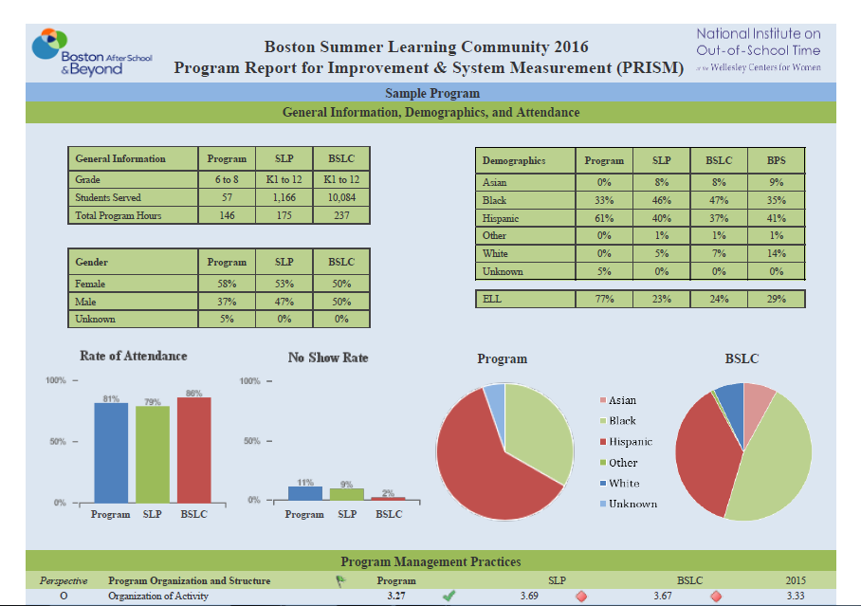
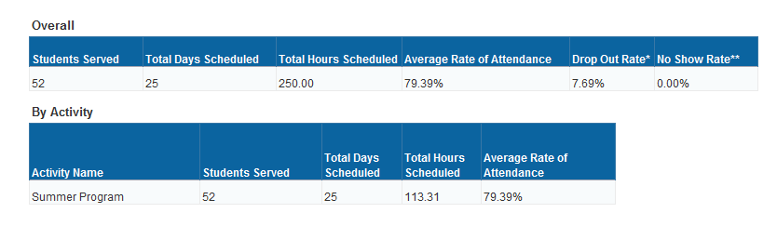
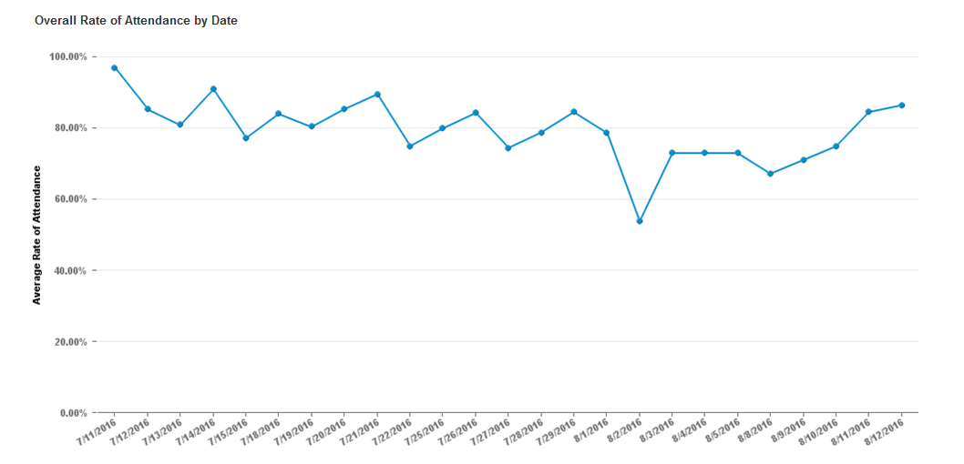
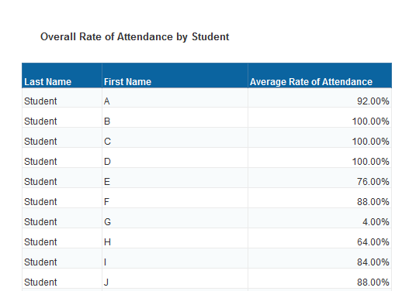
2
Access PRISM, attendance data and more on Cityspan
boston.cityspan.com
Notes:
Click on PRISM to log in to Cityspan. Show how to access PRISM, attendance data.

Slide 18
3
Offer feedback on this event via our online survey...
www.surveymonkey.com/r/MaxSummerAttendance
...for a chance to win a gift card to
Notes:
Link is here, but we’ll also be sending the survey out in a follow-up email to this event.

Slide 19
4
Check out these upcoming events
Feb. 15
Action Planning Winter Session
NonProfit Center, 89 South Street, Boston
9am – 12pm
Work with the PEAR Institute and Boston Beyond to develop an action plan for the summer using data from previous years. Learn to incorporate practical skill development strategies into program design plans, set goals and indicators of success, and facilitate action planning with your staff.
Mar. 8
Culturally and Linguistically Sustaining Practices
A Workshop with Boston Public Schools
Time TBD
Join BPS to learn how to incorporate program practices that meet the Superintendent’s goal of “sustaining and affirming the cultural, racial, and linguistic identity” of youth attending your program.
Mar. 22
Communicating Data to External Audiences
A Workshop with Boston Beyond
9am – 12pm
Explore strategies to communicate program evaluation results to a variety of external audiences, including funders, parents, and Board members.
Notes:
Kelsey Cowen to update; present at session. Close out session.

