Slide 1
Advancing Quality Partnerships Winter Summit January 17, 2017

Slide 2
School Year Initiatives Growth Over Time

Slide 3
Membership Level of Participating Sites

Slide 4
AQP + BoSTEM Data Findings, Fall 2016 Katie Tosh, Director of Measurement Boston After School & Beyond

Slide 5
Contents
Enrollment & Attendance Findings
ACT Framework Update
Measurement Findings
Youth Social-Emotional Skill Baseline
Program Practice Baseline
Trends over Time
Summary
Update on Observer Certification Process

Slide 6
AQP + BoSTEM Initiative Overview
40 BPS Schools Serving Grades K-12
25 Partner Organizations
operating at 56 sites
Students Served: 1,802 Attendance Rate: 80%
(71% of 56 sites, n=40) (48% of 40 sites, n=19)
Notes:
And to get right into the first piece of data from the fall, let’s look at reported enrollment and attendance rates. As of early January, programs reported serving 1,802 students. This is from only 40 of the 56 sites – some sites are doing spring semester only, fall data uploads are pending from some sites. The projections you all gave us were to serve around 3,500 students this year, so we expect this number to increase. .
The average attendance rate is 80%. This is only for 19 sites – of the 40 who reported enrollment and attendance data, some of those still have some data cleaning to do so holidays and unscheduled program days aren’t artificially pulling down the attendance rate. Kelsey will have some tips on how to do this. Overall this is better shape that we were this time last year with attendance data entry, and I think the vast majority of sites have established plans with Kelsey to get attendance data in.

Slide 7
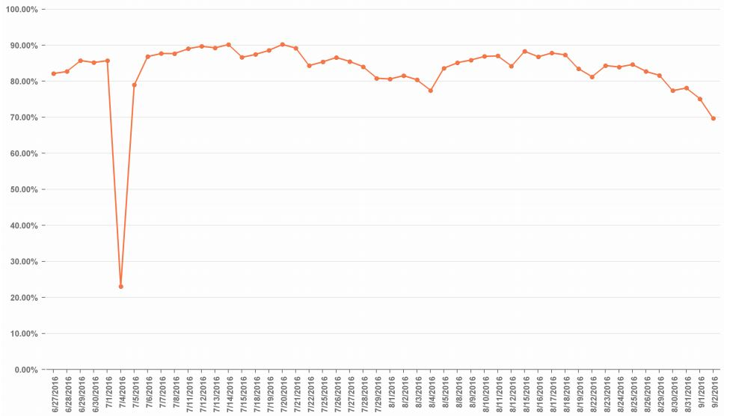
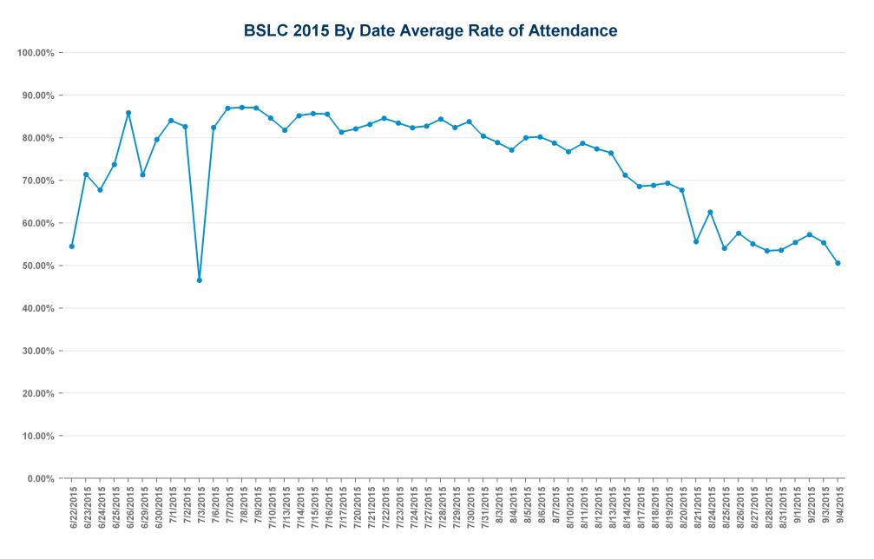
BSLC By Date Average Rate of Attendance, 2015 and 2016
July 3, 2015
July 4, 2016
2015 dates
2016 dates
2015 by date average rate of attendance
2016 by date average rate of attendance
Notes:
Lastly on attendance, we can look at the by date average rate of attendance. This is last year’s data. We saw that attendance was slow to pick up for programs that started at the end of June, and saw that attendance trailed off as we got towards the end of summer. We also saw a drop in attendance on the Friday of July 4th weekend, which was July 3rd.
Overlaying 2016 data on top, we can see some differences. First, the line overall is higher, reflecting better attendance and student retention in the programs. We notice the slow uptick in attendance at the start of the summer wasn’t as prominent, but also that programs started a few days later this year. We can also see that the drop off in attendance at the end of the program is pretty similar to last year. Although our overall attendance rates are higher, the slope of these two lines is similar, so the trend is still occurring even with higher rates of attendance on those days. We also see a much bigger drop in attendance for the holiday weekend because July 4th fell on a Monday this year.
For attendance, keep in mind: good recruitment efforts so that students who sign up for the program are coming and not dropping out, strategies to ensure students become high attenders, and that students attend throughout the entire summer.

Slide 8
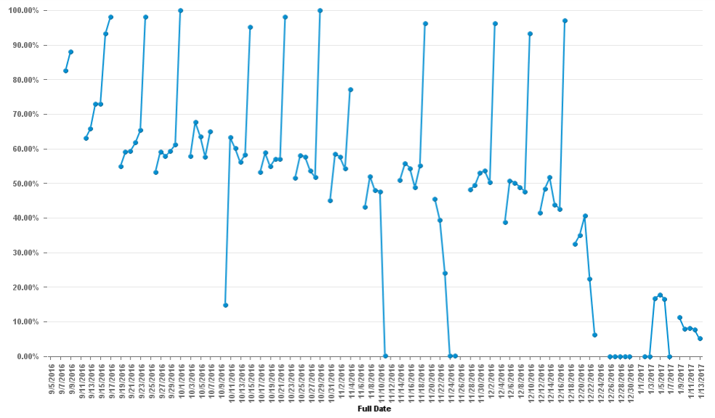
AQP + BoSTEM All Sites By Date Average Rate of Attendance
9/5/2016 – 1/13/2017

Slide 9
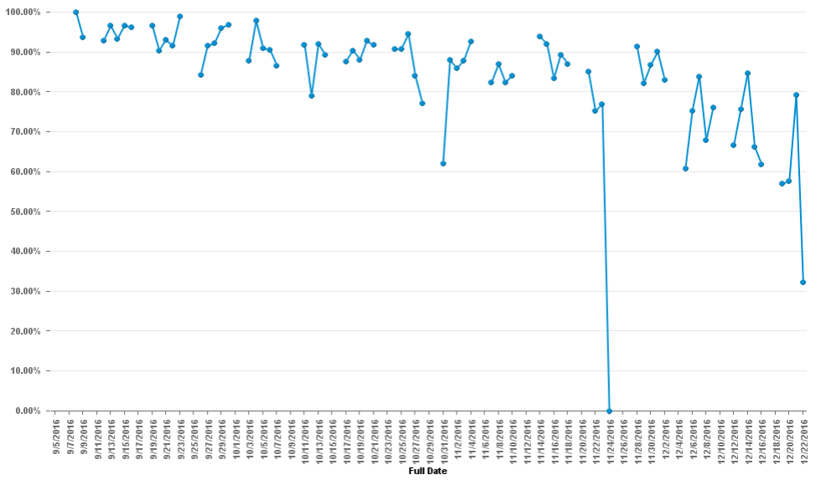
AQP + BoSTEM Complete Data Entry Sites Only, By Date Average Rate of Attendance
9/5/2016 – 12/22/2016

Slide 10
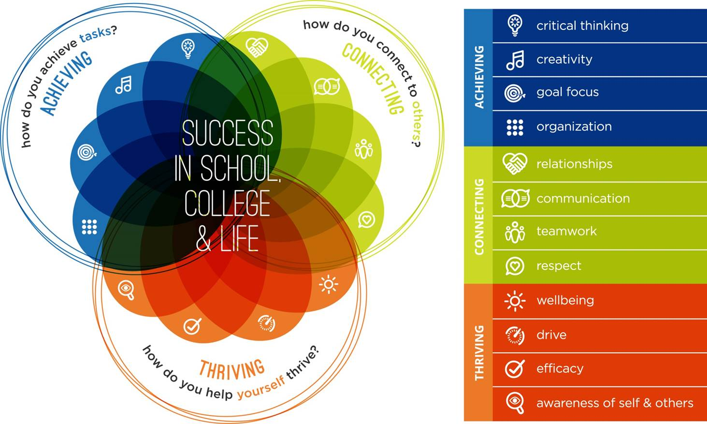
ACT Framework Update

Slide 11
Potential Revision to the ACT Framework (draft)
ACT Skills Framework
ACHIEVING | Critical Thinking
 | Creativity
 | Perseverance
CONNECTING | Social Awareness & Relationships
 | Communication
 | Teamwork
THRIVING | Growth Mindset
 | Efficacy
 | Self-Regulation
Update to reflect recent research and youth development work nationally
Align terminology of ACT Framework and measurement tools
Established shared definitions of skills
Notes:
You’re all familiar with the ACT Framework, which was created in 2010 to unite the city’s out-of-school time programs around a common youth agenda, and outlines the skills that research and practice tell us are important for youth to have in order to be successfully in school, careers, and life. We’ve been working over the past year to update the ACT Framework, and this work will continue for about another year. You wouldn’t necessarily think that a framework would need revision after only six years, but since it was created, there has been a lot of research and work nationally on youth development and in particular on social-emotional learning. So we want to update the ACT Framework to reflect that research and remove redundant outcomes, as well as align terminology of the framework and measurement tools so that the links between the framework and data are more clear, and establish shared definitions of skills to guide our collective work.
We’ve been doing this in close collaboration with our research partners, NIOST and PEAR, with the RAND Corporation, and with valuable feedback from a group of summer and school year partners who have graciously given their time to serve on our Partner Advisory Group on Measurement. So here’s the latest draft of a potential revised framework. We’ve piloted new measures in collaboration with NIOST and PEAR to capture more of these outcomes and associated program practices with our tools, but gaps still remain in our ability to measure creativity, growth mindset, and self-efficacy, nor is this list and arrangement of skills final or set in stone. But it is how we’ll be framing the results of this summer’s data collection work.

Slide 12
Outcomes Associated with ACT Skills: Achievement (academics, life) and Behavioral (personal, social)
ACT Skills Framework |  | Associated Outcomes from Research Review
ACHIEVING | Critical Thinking | College success and workforce readiness; Employee selection by management
 | Creativity | Improved academic achievement
 | Perseverance | High education attainment; Higher undergraduate GPAs; Fewer career changes; Work habits and task persistence; Math achievement
CONNECTING | Social Awareness & Relationships | Improved academic test scores; Better job performance; Improved grades; Healthier relationships; Improved social skills; Improved self-efficacy, problem-solving
 | Communication | Healthier social relationships; Improved self-efficacy
 | Teamwork | Improved academic achievement; Improved self-efficacy
THRIVING | Growth Mindset | Improved performance and academic achievement; Lower stress levels
 | Efficacy | Improved academic achievement; Academic persistence; College GPA, persistence; Improved work performance; Improved perseverance
 | Self-Regulation | Positive academic outcomes (grade promotion, test scores, course grades); College GPA and retention; Positive social outcomes (better impulse control, more stable relationships, increased empathy and perspective taking, more constructive response to anger)
Notes:
Briefly, I wanted to highlight the research base on these skills, which provides evidence for their importance in achievement in school, college, and the workplace, and personal and social outcomes. You’ll notice that the Achieve domain is very much supported by evidence of gains in school, college, and careers, while the Connect and Thrive domains evidence base includes both achievement and behavioral outcomes.

Slide 13
Measurement Results
Notes:
So, with that in mind, let’s proceed to the results around program practice and youth skill development.

Slide 14
What Questions Are We Answering?
Youth Social-Emotional Skills
What percent of program participants demonstrated skills “usually/often” or “always” at the start of the program?
Do these results vary across the educator and youth perspectives?
Program Practices
To what extent did programs deliver practices that build ACT skills “most of the time”?
Presentation Legend
= Adult rating (observer if program practice data; teacher/staff if youth skill data)
= Youth rating (of either program practice or self-report on skills)
Notes:
We hypothesize that intentionality in practice matters a great deal for youth social-emotional skill development, and that is the guiding theme for how the rest of this presentation is organized. Having such a large group of programs all using the same tools to capture program practice and youth skill outcomes allows us to dig deeper into this hypothesis, and it’s something RAND will be looking at in a correlational way with our data over the next year.
For today, we’re looking at:
-What percent of participants demonstrated skills “usually” or “always” at the start of the program?
-Do these results vary across the educator and youth perspectives?
-To what extent did programs deliver practices that build ACT skills “most of the time”? So that’s the benchmark we’ll look for.
Here’s the cheat sheet for the presentation. Anything in solid color is from the adult perspective, and anything in an outlined box is from the youth perspective. The colors correspond to the Achieve, Connect, or Thrive domains. In your folders there is a handout that looks like this. It has the definitions of each skill, examples of program practice that intentionally build that skill, and on the reverse has the results so you can follow along.

Slide 15
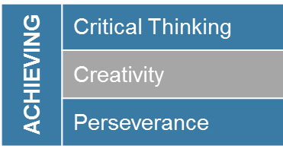
Achieve: Youth Skill Baseline
= Staff/Teacher Rating of Youth Skills (n=614 students, 17 progs)
= Youth Self-Rating of Skills (n=156 students, 8 progs)

Slide 16
Connect: Youth Skill Baseline
= Staff/Teacher Rating of Youth Skills (n=614 students, 17 progs)
= Youth Self-Rating of Skills (n=156 students, 8 progs)

Slide 17
Thrive: Youth Skill Baseline
= Staff/Teacher Rating of Youth Skills (n=614 students, 17 progs)
= Youth Self-Rating of Skills (n=156 students, 8 progs)

Slide 18
Intentional Program Practice Builds ACT Skills
Achieve Practices
Connect Practices
Thrive Practices
Cross-cutting
Practices
Almost Always
Most of the Time
Sometimes
Never
= Observer Rating, AQP & BoSTEM Fall 2016 (n= 41 programs)
*AQP programs only (n=29)
Frequency with which program practices that develop certain social-emotional skills occur; APT and DoS data.
Notes:
Similar pattern and performance levels as fall 2015.
Pretty strong in practices that could develop self-regulation. This one deserves a bit more explanation, as the practices pulled out here are very much related to how program staff respond to youth when the student is experiencing a problem or maybe exhibiting poor self-regulation, and how staff help youth resolve conflicts. It does not reflect any practices to teach youth about self-regulation or emotion control before there is an issue, so something to keep in mind there.

Slide 19
The percent of programs meeting the benchmark in practices that build ACT skills varies across specific skills
Practices Building “Achieve” Skills
Practices Building “Connect” Skills
Practices Building “Thrive” Skills
Cross-cutting
Practices
= Observer Rating, AQP & BoSTEM Fall 2016 (n= 41 programs)
*AQP programs only (n=29)
Percent of programs meeting the benchmark for desired frequency of program practice; APT and DoS data.

Slide 20
More programs meeting benchmark for critical thinking and leadership/choice in 2016, with declines in perseverance, teamwork, and engaging activities
Practices Building “Achieve” Skills
Practices Building “Connect” Skills
Practices Building “Thrive” Skills
Cross-cutting
Practices
= Observer Rating, AQP Fall 2015 (n=15 progs)
= Observer Rating, AQP & BoSTEM Fall 2016 (n= 41 programs)
*AQP programs only (n=29)
Percent of programs meeting the benchmark for desired frequency of program practice; APT and DoS data.

Slide 21
BoSTEM Fall program quality baseline over time (2015-2016)
Features of
Learning Environment
(Org & Structure)
Youth Development
(Supportive
Environment)
Engagement
in Activities
and Learning
STEM Knowledge
& Practices
Compelling Evidence
Reasonable Evidence
Inconsistent Evidence
Evidence Absent
= Fall 2015 (n=8)
= Fall 2016 (n=14)
Extent to which there is evidence of programmatic practices happening.
DoS Data (Observer Perspective), Average Scores of BoSTEM programs

Slide 22
Summary

Slide 23
Summary: Reach and Dosage
Reach: 56 programs serving 1,802 youth
Average Rate of Attendance: 80% (range 62%-98%)
Data Collection: 70% of sites have some level of data entry or cleanup needed related to attendance data, but overall are in good shape with progress and plans

Slide 24
Summary: Program Practice
44% - 86% of programs hit the benchmark of quality practice, with variation across which skill the practices are meant to build
Challenge areas are present across ACT domains:
Achieve: critical thinking
Connect: communication, teamwork
Thrive: self-regulation
Cross-Cutting: engaging activities, youth leadership and choice
Over time, the growing AQP and BoSTEM initiatives have maintained strong practice with general scores at or above the benchmark and made gains in challenge areas
Drop in quality of practice from spring to fall
emerged as a new challenge

Slide 25
Summary: Youth Skill Demonstration
On average, youth participants assess themselves more positively in all ACT skills than program staff do
Areas for skill growth:
Achieve: perseverance, critical thinking
Connect: communication, teamwork
Thrive: self-regulation
Growth opportunities align across youth skills and program practice

Slide 26
BASB Certified Program Observer Training
Updates and Next Steps
Kelsey Cowen, Data Fellow Boston After School & Beyond

Slide 27
Phase 1 of School Year Pilot
26 Program Staff
10 Organizations
Step 1: Self-paced online training in the Assessment of Program Practices Tool (APT)
Step 2: Practice observation in a familiar setting
Step 3: Tandem observation with a NIOST master observer
Step 4: Ratings collected during tandem visit undergo reliability rating
Notes:
As many of you know, this fall BASB piloted an observer certification training process. In the fall, 26 individuals representing 10 of our partner organizations participated in the pilot where they: OUTLINE THE PROCESS. Since the tandem visits in the fall, NIOST has put your tandem observations ratings through a standardized reliability rating procedure. Using the scores of NIOST’s master observer alongside those of the trainee that observed the same program, the reliability rating shows the percentage

Slide 28
Reliability Rating
Trainee’s Ratings
How often
do they match
within 1 point?
Master Observer Ratings
90% threshold
Notes:
Using the scores of NIOST’s master observer alongside those of the trainee that observed the same program, the reliability rating shows the percentage of cases where the trainee’s ratings were within one point of the master observer’s. The reason it’s within one point is because there may be circumstances in which one observer saw or heard a piece of evidence that the other did not capture in their observation. This evidence may cause the observer to score an item higher or lower than the other depending on how it affected the activity from their perspective. The threshold set by NIOST and BASB is 90% agreement, that is that your ratings were within one point of the master observer’s at least 90% of the time. The goal of this training process is to have every individual in the training be at or above the 90% threshold to become certified. Some of you are already there and others may require some additional NIOST coaching to reach 90% reliability, so...

Slide 29
Next Steps (Phase 2)
In the next few weeks:
Each trainee receives feedback from NIOST
In the next few months:
Trainees requiring additional training complete a second tandem observation
March 8, event on Mitigating Observer Bias:
Trainees receive their BASB Program Observer Certification
All program partners can attend
After March 8:
NIOST begins scheduling spring program observations
Newly Certified Program Observers go into the field and report observation ratings to BASB
Notes:
Here are the next steps: In the next few weeks, NIOST will reach out to each trainee individually with feedback on your reliability rating, any quick tips to make your observations more successful, and your personal next steps. NIOST will recommend that trainees who did not meet the 90% threshold after the fall tandem visit complete a second tandem observation with a NIOST master observer and go through the reliability rating process again. NIOST master observers will continue to be available for additional coaching or support. The second round of tandem visits will likely happen in the next few months in preparation for an event on March 8 where trainees will receive their certification, and learn strategies to mitigate bias in their program observations. This event is not solely for individuals who participated in the training. All program partners are invited to attend, so if you’re interested in participating in the training at some other point in time, or in understanding observer bias as it pertains to the tools BASB uses for program observations, feel free to come along! In the spring, NIOST will be working with each of our newly Certified Program Observers to coordinate spring APT visits. Certified Program Observers will report their spring visit ratings to BASB for SY 16-17 PRISMs.

Slide 30
Exploring the Insight Center to Link Data to Practice Danielle Kim, Director of Policy & Communications Boston After School & Beyond

Slide 31
Summer Insight Center
summerinsight.bostonbeyond.org

Slide 32
More feedback to share?
Contact:
Danielle Kim
dkim@bostonbeyond.org
617-345-5322 x280

Slide 33
Wallace Foundation Partnerships in Social and Emotional Learning
KC Kato, Director of SEL Initiative, BASB
Jonathon Sproul, Director of School-Community Partnerships, BPS

Slide 34
Theory of Action
To foster children’s social and emotional learning (e.g., intrapersonal, interpersonal and decision making skills), districts AND out-of-school time intermediaries will partner to enable leadership and staff in schools AND OST programs to effectively teach and develop these skills.
In order to help students build their knowledge, skills and experiences they need to achieve their full potential in school, college, careers and life.
Notes:
Recognizing that Social and Emotional Learning skills are the foundation needed to be able to learn.

Slide 35
Success Model
Explicit SEL Instruction
Climate & Culture
Integrated SEL Academic Instruction and OST Program Content

Slide 36
PSEL Initiative Model Mirrors OST Current Work
Intentional SEL
SEL integrated into program content
Collaborative among BPS, BASB and OST Program Partners

Slide 37
PSEL Initiative Overview
Core Team
Workgroups
Initiative/Intervention Design
Common Vision and Language: SEL Frameworks/Standards
Professional Development
Measurement
Community Partnerships
Notes:
Core Team
Amalio Nieves Chris Smith
Carla Burley KC Kato
Marta Gredler Danielle Kim
Monica Hogan Katie Tosh
Jill Snyder
Jon Sproul

Slide 38
Timetable
January – Plan for Plan
February-April – Work Groups
April 30th – Plan DUE
June - Pilot Awarded

Slide 39
How can you help?
Advise
Partner
Champion
Notes:
Advise:
While many of the partners are serving older youth, based your experience, what could we be doing to support students before you see them?
Identify student needs
Priorities
How to integrate into content
Partner:
Continue the great work you’re doing with youth
Partner with school leadership
Work with us to strengthen SEL opportunities
Champion

Slide 40
Questions, Comments, Suggestions?

Slide 41
BOSTON PUBLIC SCHOOLS
Advancing Quality Partnerships
BPS School-Community Partnerships
January 17th, 2017

Slide 42
BOSTON PUBLIC SCHOOLS
Objectives
Learn more about BPS school-community partnership landscape
Review BPS Elements of Effective Partnership
Put Elements of Effective Partnership into Practice
Identify individual and collective roles in Strengthening Effective Partnership across BPS

Slide 43
BOSTON PUBLIC SCHOOLS
School-Community Partnership Landscape

Slide 44
BOSTON PUBLIC SCHOOLS
School-Community Partnership Numbers as of January 2017
765 Organizations
Offering 1019 Programs
Through 3537 School-Community Partnerships

Slide 45
BOSTON PUBLIC SCHOOLS
Problem of Practice

Slide 46
BOSTON PUBLIC SCHOOLS
How do we ensure that schools and their school-community partners are partnering effectively to provide high quality learning opportunities and supports that positively impact holistic outcomes for students, families and/or schools?

Slide 47
BOSTON PUBLIC SCHOOLS
Elements of Effective Partnership

Slide 48
Defining Effective Partnerships
Effective School-Community Partnerships are intentional collaborations between schools and School-Community Partners to provide high-quality learning opportunities and supports that positively impact holistic outcomes for students, families, staff and/or schools.
Effective Communication
Coordinated Services
Results Driven
Shared Accountability
Strategic Alignment
Elements

Slide 49
Examining the Elements
Strategic Alignment
School and Partner work proactively to understand and incorporate school priorities and instructional focus into partner programming
School and Partner work together to adjust programming based on priorities, and school, student and community needs.
Coordinated Services
School and Partner work intentionally to build relationships with other partners in the school, school staff, and parents/families
School and Partner work to streamline services with those of other partners and the school, gain awareness of potential overlaps in service, and develop effective referral processes
Shared Accountability
School and Partner work together to establish shared goals
School and Partner have clearly outlined and documented agreements on scope of services
Results Driven
School and Partner have a plan in place for tracking progress towards shared goals
School and Partner regularly review progress toward these goals and outcomes.
Effective Communication
School and Partner communicate regularly
School and Partner share information and provide/solicit feedback from one another and other partners.
Notes:
Which elements resonate with you the most? What are some best practices that you can share around them?

Slide 50
BOSTON PUBLIC SCHOOLS
Turn and Talk
Review Partnership Effectiveness Self Assessment
Key Questions:
What elements have you focused on?
What has worked?
What has been challenging?

Slide 51
BOSTON PUBLIC SCHOOLS
Putting the Elements into Practice

Slide 52
BOSTON PUBLIC SCHOOLS
School Profile: Boston Elementary School
School Priorities
60 Partners
Increasing requests to partner
Increase opportunities for students to engage in cognitively demanding tasks
Current Challenges
Focus on social emotional learning as a key strategy to increasing academic performance
Ensure equitable access to enrichment activities for all students
No designated partnership coordinator
High population of students facing homelessness
Moving to Extended Learning Time next year
Partnership Landscape

Slide 53
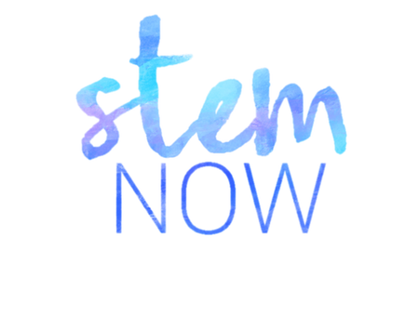
BOSTON PUBLIC SCHOOLS
Partner Profile: STEM Now!
Program Description
STEM Now! provides opportunities for girls to engage in the STEM field. The program leads field trips to local STEM companies, provides hands on STEM learning activities, and work with students to develop a science project culminating in a science conference at the end of the year.
Service Delivery
Operates after school, typically from 2:30-5:00
Serves girls in grades 3-5
Partner Priorities
Increase number of students served
Runs programming Monday-Thursday
Create more continuity in programming offered throughout the year
Enhance quality of learning activities

Slide 54
BOSTON PUBLIC SCHOOLS
Strategic Alignment: Boston Elementary School
STEM Now! is running their program at Boston Elementary School for the first time this year.
What are some questions they should ask the school administration, students, and families to ensure that their program is Strategically Aligned to the unique needs and priorities of the school?
What ways might they offer to adjust their programming to Strategically Align with some of challenges the school is currently facing?

Slide 55
BOSTON PUBLIC SCHOOLS
Coordinated Services: Boston Elementary School
STEM Now! has noticed that it is one of four after school programs operating at the school, and has seen an overlap in the students being served by all four of these programs.
What challenges may be coming up for these programs related to Coordinating Services?
How can STEM Now! initiate Coordination of after school Services in order to streamline programming and ensure that they are contributing to the school’s priority of providing equitable access to enrichment opportunities for all students?

Slide 56
BOSTON PUBLIC SCHOOLS
Shared Accountability: Boston Elementary School
STEM Now! is eager to establish a partnership agreement with Boston Elementary School to develop shared goals, objectives and expectations, but the school has not been able to prioritize time to develop and complete this agreement with STEM Now!
What challenges may the school face that inhibit it from taking the steps necessary to establish a partnership agreement that outlines Shared Accountability?
What are some creative ways that STEM Now! can continue establishing Shared Accountability at the school despite these challenges?

Slide 57
BOSTON PUBLIC SCHOOLS
Results Driven: Boston Elementary School
STEM Now! is a national program and has a set of organization-wide metrics that it uses to measure the results of its work.
How can STEM Now! incorporate Boston Elementary School’s priorities into the metrics that it has already established to ensure that the partnership is mutually Results Driven?
What are some creative ways that can STEM Now! can work with the school to regularly report and get feedback on its results throughout the year?

Slide 58
BOSTON PUBLIC SCHOOLS
Effective Communication: Boston Elementary School
STEM Now! has historically met with the principals or partnership point of contact of the schools in which they partner three times a year. They have yet to meet with Boston Elementary School this year, and have had trouble getting in contact with the principal.
What are some challenges the school is facing that could be barriers to engaging in Effective Communication with STEM Now!?
What are some creative ways that can STEM Now! can increase Effective Communication with the school considering the challenges the principal may be facing?

Slide 59
BOSTON PUBLIC SCHOOLS
Share Out and Closing

Slide 60
BOSTON PUBLIC SCHOOLS
What was your group’s element and scenario?
What are one or two learnings that you can apply to strengthening your own partnership effectiveness going forward?
Please nominate one or more representatives from your group

Slide 61
Recommendations & Next Steps Katie Tosh, Director of Measurement Boston After School & Beyond

Slide 62
Recommendations & Next Steps
Review PRISM Report & HSA Dashboard
How will you share results across different levels of staff to inform improvements?
What are your program’s goals for youth?
How does your program practice support those goals? Staff hiring and training?
What does the data reveal about your strengths? Challenges?
How does your staff’s experience align to or differ from your data?
What are 1-2 areas to focus on maintaining? Improving?
What training and support for staff is needed to sustain best practice into next fall?
Read up on best practices
Insight Center
Measurement Tools
Attend upcoming professional development sessions
Notes:
Refer programs to the handout of next steps and Summer Insight Center; contact me with questions

Slide 63
Upcoming events
Feb. 15
Action Planning Winter Session
NonProfit Center, 89 South Street, Boston
9 am – 12 pm
Work with the PEAR Institute and Boston Beyond to develop an action plan for the spring semester using data collected in the fall. Learn to incorporate practical skill development strategies into program design plans, set goals and indicators of success, and facilitate action planning with your staff.
Mar. 8
Mitigating Bias in Program Observations
NonProfit Center West Room, 2nd Floor, 89 South Street, Boston
9 am – 12 pm
Hear about the latest research from NIOST around bias in program observation. Learn how to spot and avoid bias in your own observations of programs. Individuals who participated in the fall pilot of BASB’s Observer Certification Training will receive their certificates.
March
Communicating Data to External Audiences
A Workshop with Boston Beyond
Time TBD
Explore strategies to communicate program evaluation results to a variety of external audiences, including funders, parents, and Board members.
Apr. 7
Adding Cognitively Demanding Tasks to Program Learning
A Workshop with Boston Public Schools’ Office of School-Community Partnerships
Time TBD
Join BPS to evaluate the cognitive demand of program tasks, and learn to incorporate tasks with higher cognitive demand into program learning.
Measurement reminders
Prepare for spring youth survey administration by making sure your participants have consent to participate!
Contact Kelsey Cowen at kcowen@bostonbeyond.org with questions or concerns about consent forms.

