Slide 1
BPS Summer Curriculum:
Impact of BPS’ February Institute on Summer Curriculum Redesign
Laryssa Doherty, Senior Program Director
Office of Professional Learning
Presentation to Boston After School and Beyond
March 22, 2016

Slide 2
Dr. Chang’s 100 Day Plan
1. All youth can and must achieve at high levels.
2. We innovate and transform teaching and learning to inspire excellence.
3. Those closest to students must be empowered and held accountable for making the most critical decisions that lead to student achievement.
4. Every child should have access to a high quality school of their choice close to home.
5. We must build a “Culture of We” that is embraced by students, staff, families, and community
Notes:
11:15

Slide 3
Redesign of Summer Curriculum
Following the success of Expeditionary Learning (EL) curriculum and task-based math lessons in both SLP programs and BPS expansion during the traditional school year, a redesign of the Summer curriculum for all students became a district priority for Summer 2016
We wanted to focus on teacher leadership and harness the expertise gained at the school level when creating lessons and support resources
In order to achieve this goal, we created an early hiring process to attract teachers that are already teaching EL and/or task based lessons and offered the February Institute to develop a deeper understanding of these curricula as well as curriculum resources for Extended Learning Time Programs
Notes:
Connection

Slide 4
February Institute Focus Question:
How do we ensure that ALL students have access to CDTs?
Notes:
Foundation of the work: February Institute

Slide 5
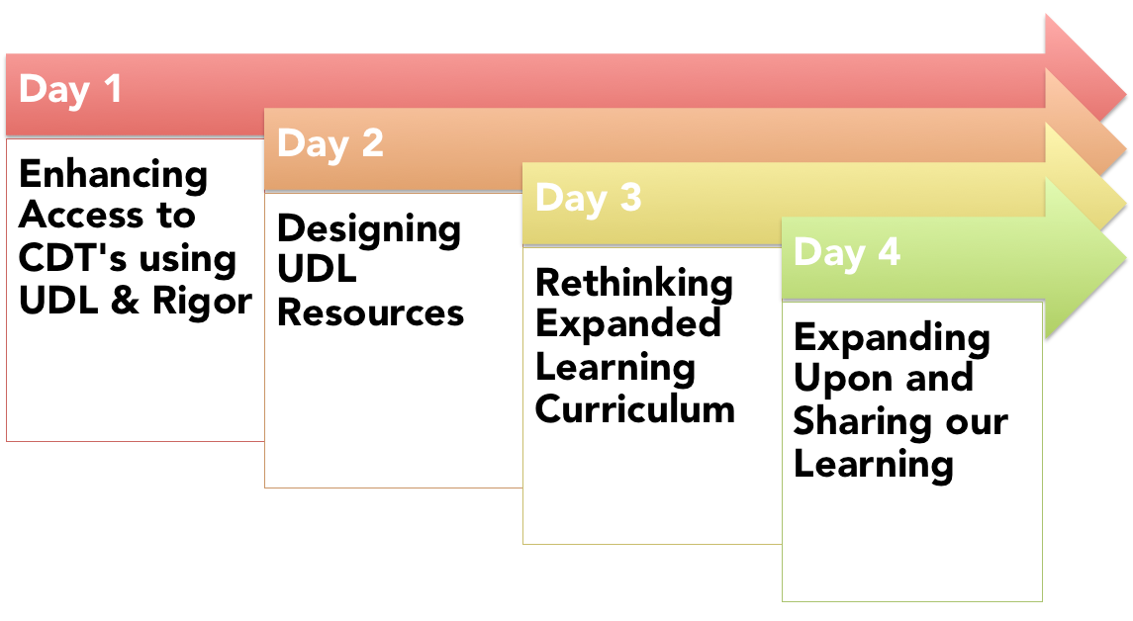
Notes:
We will focus on Rigor today, but will touch on UDL later

Slide 6
Participants
56 Teachers
20+ Partners
34 Schools
10 Accel. Acad. Sites
Accel. Acad partners
Summer Partners

Slide 7
Objectives
Develop a deep understanding of cognitively demanding tasks and UDL principles of access for ALL learners.
Demonstrate understanding through modification of upcoming lesson/task that will be implemented by teachers following the Institute in their own classrooms.
Collaborative development and design of district-wide Extended Learning Time Grades 3-8 curriculum for April Acceleration Academy and Summer Learning programs.

Slide 8
Two ELT Curriculum Pathways:
Collaboration within ELA & Math
ELA:
Understanding the Expeditionary Learning (“EL”) curriculum and preferred strategies for accessing complex text
Identifying and addressing barriers in the Summer EL units by developing resources documents
Creating CDTs and corresponding resource documents focused on addressing barriers for core texts that will be studied during April Acceleration Academies
Math:
Studying the math taxonomy for cognitive demand and adapting tasks to meet cognitive demand as well as UDL principles
Examining lesson protocols and task-based lessons
Creating cognitively demanding, task-based lessons with a UDL lens that will be implemented during April Acceleration Academies

Slide 9
CDT?
CDT: Cognitively Demanding Task:
Cognitive Demand – The cognitive demand is the kind and level of thinking required of students in order to successfully engage with and solve the task.
(Stein, M. K., Smith, M. S., Henningsen, M. A., & Silver, E. A., 2000. Implementing standards-based mathematics instruction: A casebook for professional development.)
*Boston Public Schools predominantly use Webb’s Depth of Knowledge to determine the cognitive demand of a task.

Slide 10
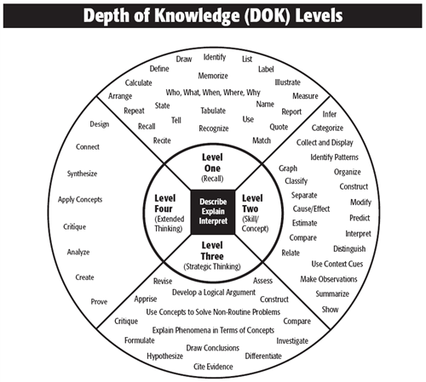
Notes:
In BPS, we are defining Rigor with the Webb’s DoK.
Most schools are using a combination of Bloom’s or Marzano’s Taxonomy, Webb’s and or Hess Matrix (combines Webb’s and Bloom’s)
Deep PD for principals and content level PD in departments regarding what rigor looks like in each content area

Slide 11
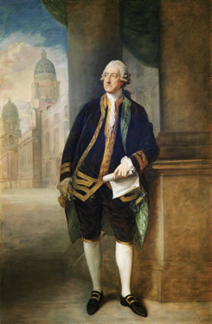
1. Recall |  | Recall of fact or definition or concept Routine/simple procedures
2. Skill |  | Finding and using explicit information given Multi-step procedures that involve basic decision-making Usually a single correct answer or outcome
3. Strategic |  | Apply skill/concept knowledge to a larger problem or challenge Typically involves reasoning, judgment, and inference Usually more than one possible answer or outcome
4. Extended |  | A longer term investigation/application to the real world Typically involves research and creation of a work Often integrates other disciplines and content areas

Slide 12
Myths of Rigor
Myths about Rigor …

Slide 13
Myth #1
Rigor = Hard

Slide 14
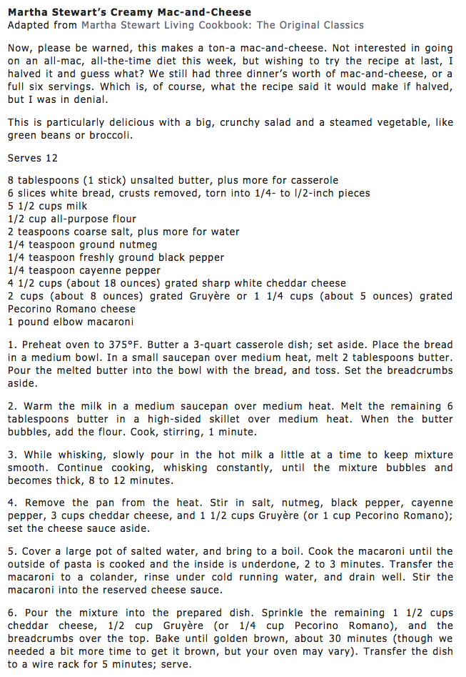
vs
Both are DOK 2, though one is DEFINITELY harder

Slide 15
Myth #2
Rigor = MORE

Slide 17
Myth #3
Rigor = Gifted / Talented
or
Rigor ≠ Students w/ IEPs

Slide 18
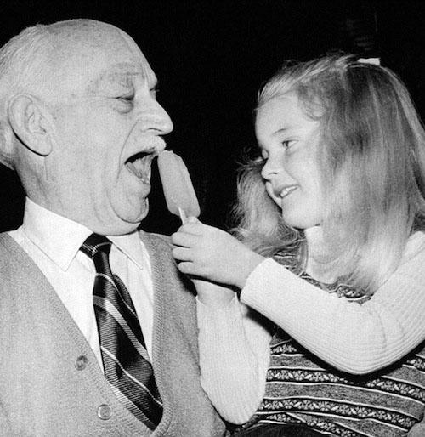
Both are DOK 4, though one requires more domain expertise and knowledge.
vs
In 1905, eleven-year-old Frank Epperson
invented the Popsicle
Chef René Redzepi
and Æbleskiver and muikku

Slide 19
Myth #4
Support ≠ Rigor

Slide 20
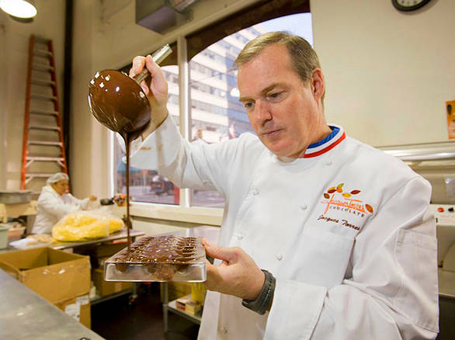
“I have the same kitchen tools at home as I have at Le Cirque -- a Kitchen Aid stand-up mixer …”
Even Jacque Torres (pastry chef) uses supports strategically!

Slide 21
Myth #5
Lower Rigor = Lower Grade Level
Higher Rigor = Higher Grade Level

Slide 22
vs
One is for a “older and more sophisticated” buyer, but you are still at DOK 2

Slide 23
UDL?
UDL: Universal Design for Learning
Universal Design for Learning (UDL) is a framework that addresses the primary barrier to fostering expert learners within instructional environments: inflexible, “one-size-fits-all” curricula.
(www.UDLCenter.org)
Notes:
When we talk about rigor, often we hear about how students “can’t” (which means we haven’t yet internalized what rigor really means). Once we are able to address that concern, and have designed a task that is rigorous, we need to focus on the access points for students. One of the best “tier 1” stratgeies is implementing a UDL framework.

Slide 24
3 Principles of
Universal Design for Learning
Representation
How information is presented to students in the lesson (e.g. written text or verbal communication)
Action & Expression
How students navigate a
learning environment and
express what they know
Engagement
How students will be motivated and sustain engagement throughout the lesson

Slide 25
Theory in Practice: ELA
EL Task- Grade 6
World Without Fish
Math Grade 3 Lesson:
Math Task

Slide 26
What does this mean for Partnership Programs?

Slide 27
Greater Curriculum Coherence
Students and teachers are building upon familiar standards-based curriculum (not creating a new one), with resources that more readily assist in addressing student barriers
Teachers and partners will be expected to collaborate deeply to ensure coherence between programs
Extensive professional development for teachers and partners to build vision for the summer sessions based on needs of students and expertise of staff.
Standards, School Year, Teacher Expertise, Student Familiarity
Notes:
As we move into the summer pre-training, a large focus will be on continued coherence

Slide 28
Teacher Leadership
Teacher leaders from February Institute will be assisting in curriculum training for the summer teachers AND we anticipate at least one teacher at each site to have attended February Institute
Approximately 40% of teachers attending February Institute will be teaching during summer programs
Spring and Summer

Slide 29
Depth of Resources
Each grade level and content have a curriculum resource document that will be the guide to implementing the new curriculum.
All templates, protocols, etc for the new curriculum will be available in a shared folder that ALL staff will have access to.
Developed by Teacher Leaders, for Staff, and guided by content experts in the Office of Professional Learning

Slide 30
Looking Ahead
Tracking the success of teachers who attended February Institute (by their students)
Tracking the success of students who attend AA
Tracking the success of students who attend Summer Programs
Tracking the success of teachers who attended February Institute AND teach in a Summer Program
Tracking Success and Continuing to Build Capacity

Slide 31
Dr. Chang’s 100 Day Plan
1. All youth can and must achieve at high levels.
2. We innovate and transform teaching and learning to inspire excellence.
3. Those closest to students must be empowered and held accountable for making the most critical decisions that lead to student achievement.
4. Every child should have access to a high quality school of their choice close to home.
5. We must build a “Culture of We” that is embraced by students, staff, families, and community

Slide 32
Learning By Doing
Share/Refine your definition of rigor
Analyze the cognitive demand of a task
Modify the task to increase cognitive demand
Think about WHY that revision is appropriate
Repeat, repeat, repeat but remember--not ALL tasks should be CDTs!
Notes:
11:30
Definition of rigor 2 min + 3 min share
Analysis of cognitive rigor 3 min
Modification 5 min
11:45
Find other group members:
Discuss experience in mixed groups 2-3 min
Choose ONE to display with group put on poster (6 min)

Slide 33
CDT?
CDT: Cognitively Demanding Task:
Cognitive Demand – The cognitive demand is the kind and level of thinking required of students in order to successfully engage with and solve the task.
(Stein, M. K., Smith, M. S., Henningsen, M. A., & Silver, E. A., 2000. Implementing standards-based mathematics instruction: A casebook for professional development.)
*Boston Public Schools predominantly use Webb’s Depth of Knowledge to determine the cognitive demand of a task.

Slide 34
1. Recall |  | Recall of fact or definition or concept Routine/simple procedures
2. Skill |  | Finding and using explicit information given Multi-step procedures that involve basic decision-making Usually a single correct answer or outcome
3. Strategic |  | Apply skill/concept knowledge to a larger problem or challenge Typically involves reasoning, judgment, and inference Usually more than one possible answer or outcome
4. Extended |  | A longer term investigation/application to the real world Typically involves research and creation of a work Often integrates other disciplines and content areas

Slide 35
UDL-ification
Make sure there are multiple ways within the task to show proficiency
Determine what barriers exist that prevent students from accessing the task
ADDRESS the barriers without compromising rigor or expectations
Notes:
With partnership groups
11:55
In groups- 5 minutes
12:00 Gallery Walk with stickies: 5 minutes

Slide 36
3 Principles of
Universal Design for Learning
Representation
How information is presented to students in the lesson (e.g. written text or verbal communication)
Action & Expression
How students navigate a
learning environment and
express what they know
Engagement
How students will be motivated and sustain engagement throughout the lesson

Slide 37
Next steps
How do YOU plan to share your new experience?
What are the next steps of your organization to ensure coherence with BPS priorities?
Notes:
12:05 Look at sticky comments

Slide 38
Questions
Notes:
12:10pm

